Slide 1
Designing & Delivering Online Training Library CE Institute Online Session 3
WebJunction – Infopeople – IMLS

Slide 2
Amy
Maurice
Enid
Colleen
Katie
Tiffany
Katherine
Christine
Meredith
Jamie
Kelly
Stephanie
Notes:
1. Claim your ‘territory’ with arrow tool

Slide 3
Agenda for today
Project Check-ins
Leadership
Change
Youth
Technology
Moodle Tour
Timeline

Slide 4
Project check-ins:
challenges, successes discoveries, tips

Slide 5
May in Seattle— a training room in the sky
Notes:
Image: Seattle from Lower Queen Anne by amidfallenleaves on Flickr
https://www.flickr.com/photos/amidfallenleaves/3401062322

Slide 6
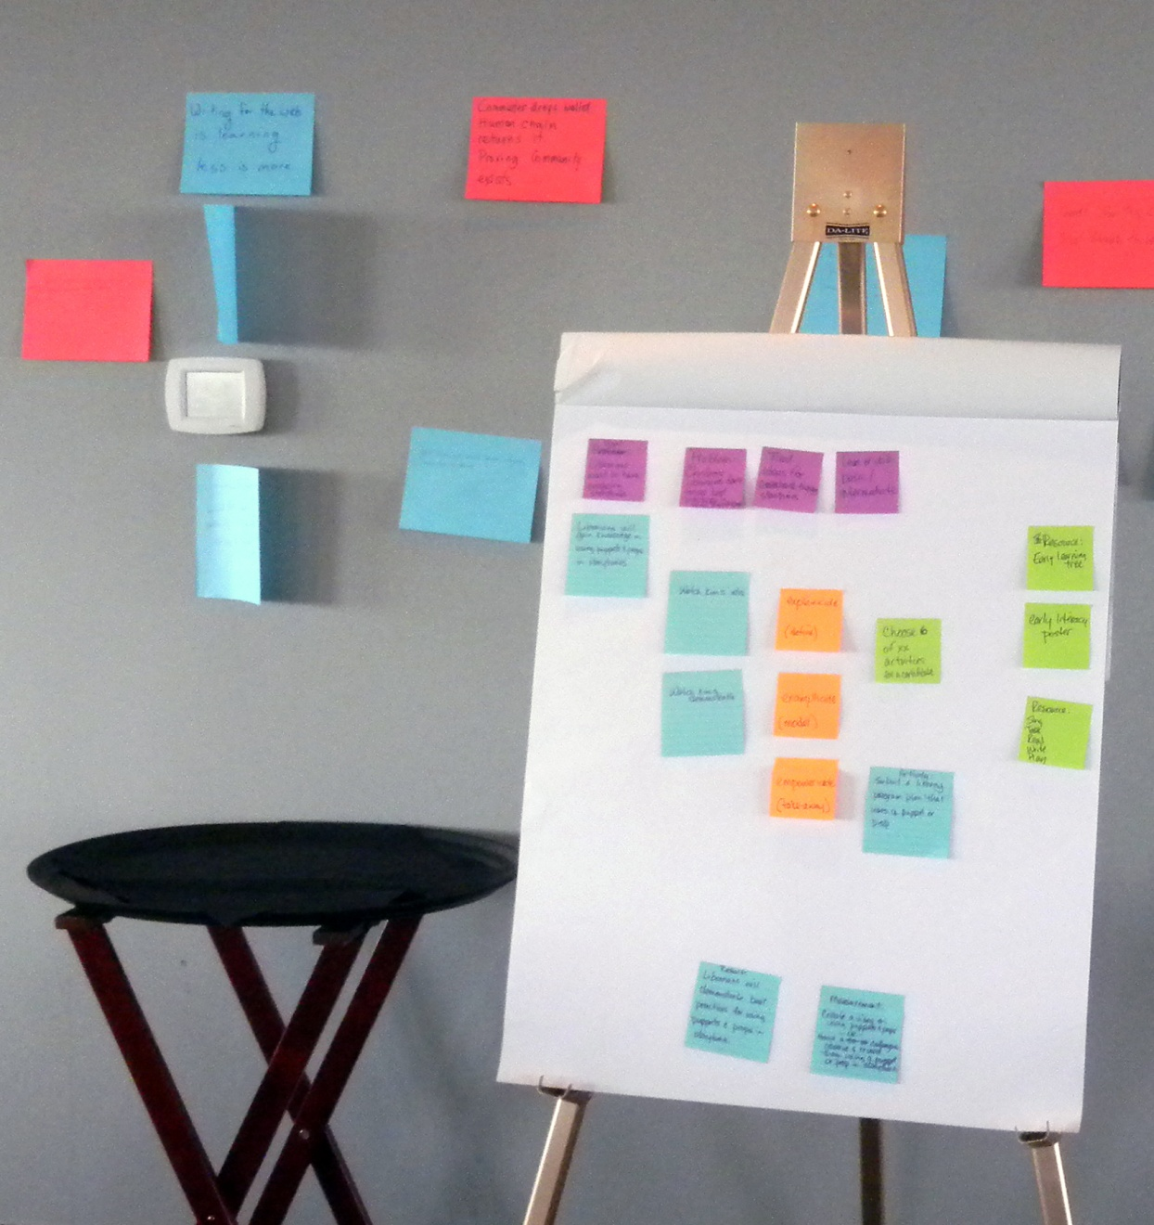
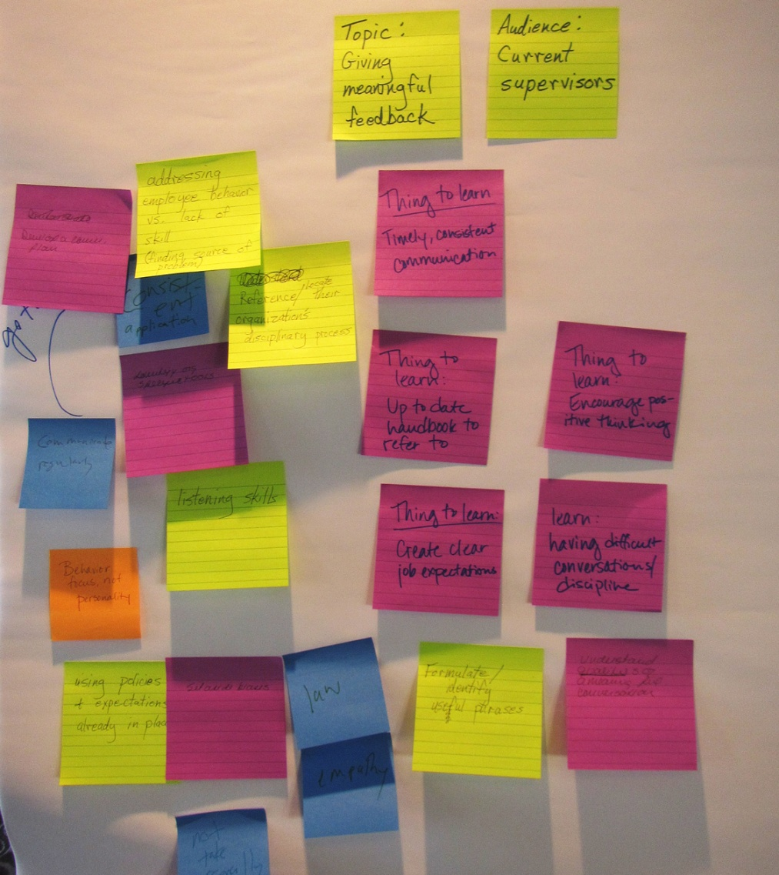
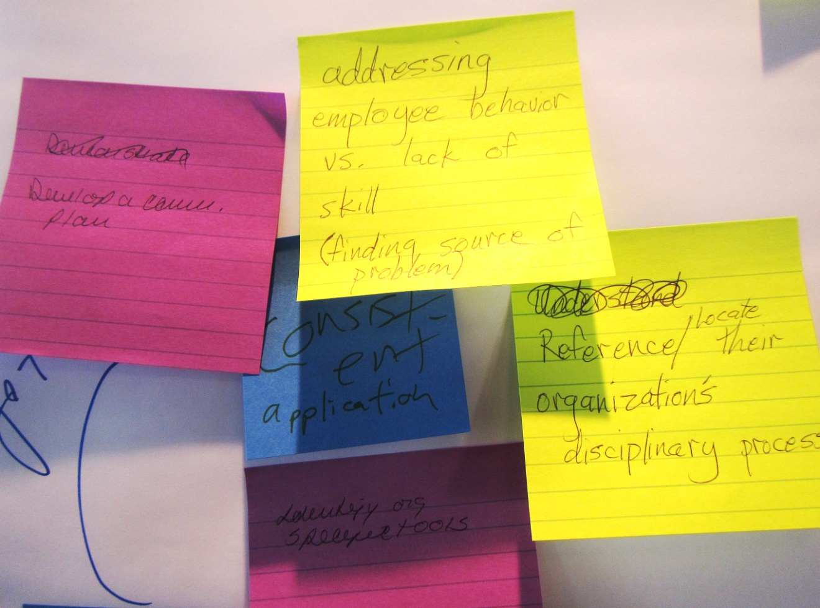
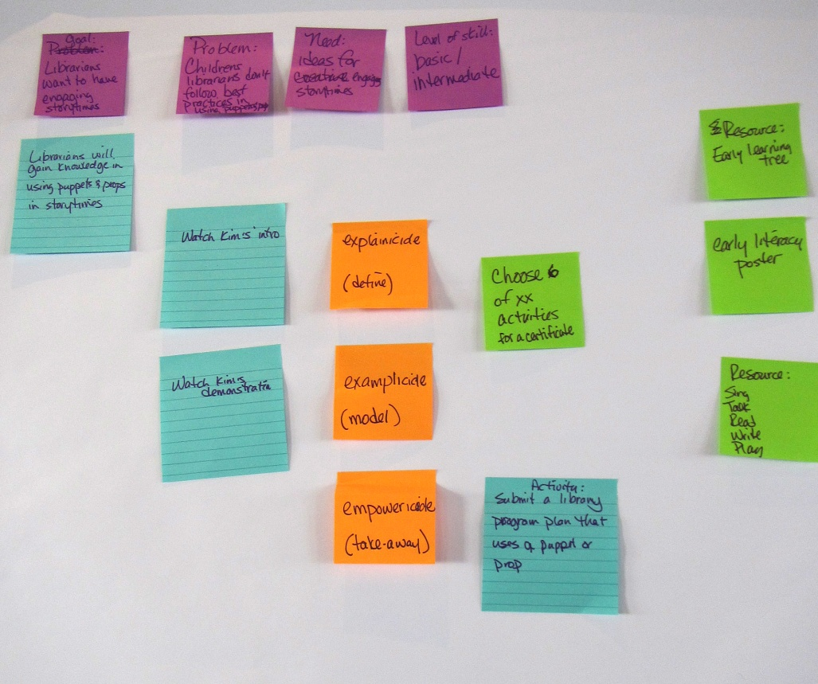
Instructional design by post-it
Notes:
Image: Seattle from Lower Queen Anne by amidfallenleaves on Flickr
https://www.flickr.com/photos/amidfallenleaves/3401062322

Slide 7
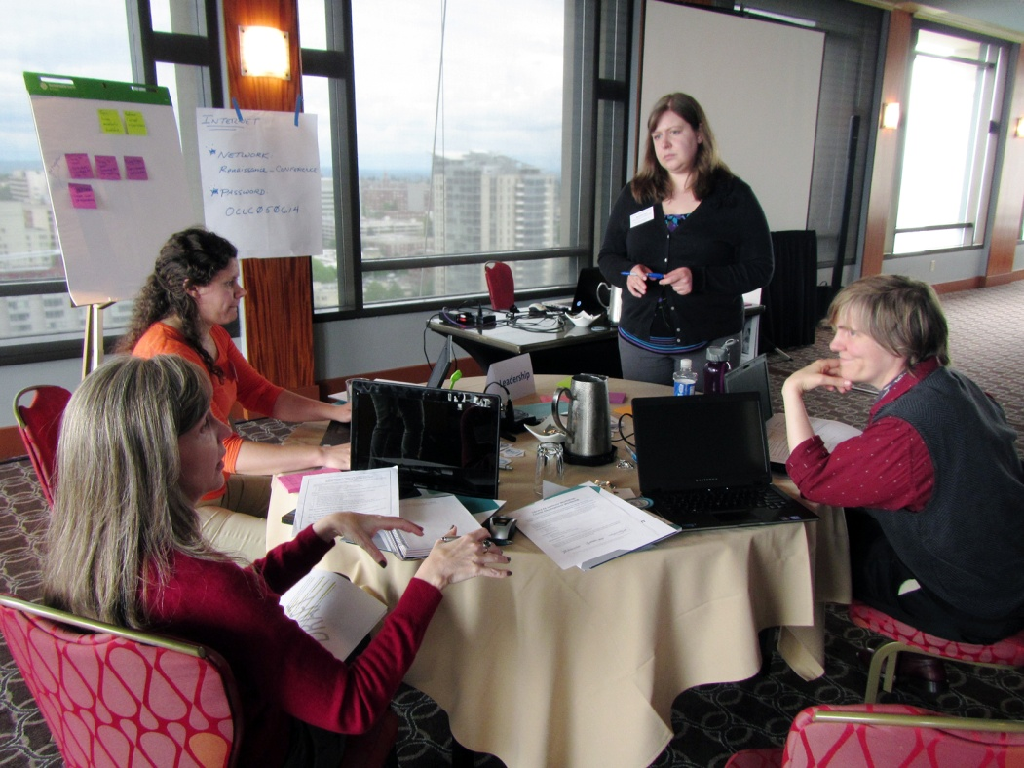
Group: leadership
Topic: Giving constructive feedback
Members
Tiffany Hayes
Christine Kreger
Meredith Lowe
Kelly Jo Woodside

Slide 8
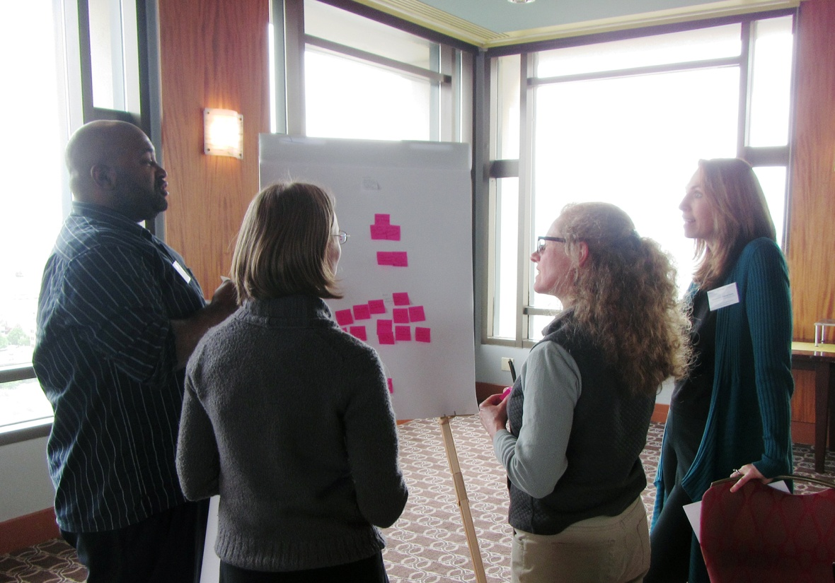
Group: change
Topic: mitigating change
Members
Katherine Adelberg
Maurice Coleman
Katie Fearer
Stephanie Zimmerman

Slide 9
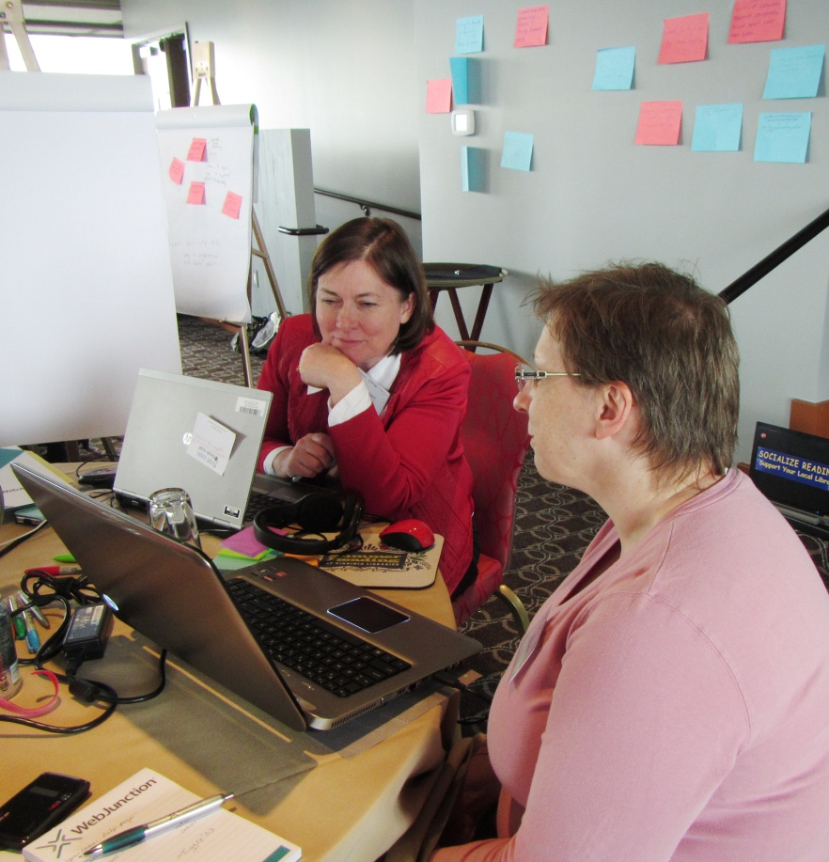
Group: youth
Topic: using puppets & props in storytimes
Members
Enid Costley
Colleen Eggett

Slide 10
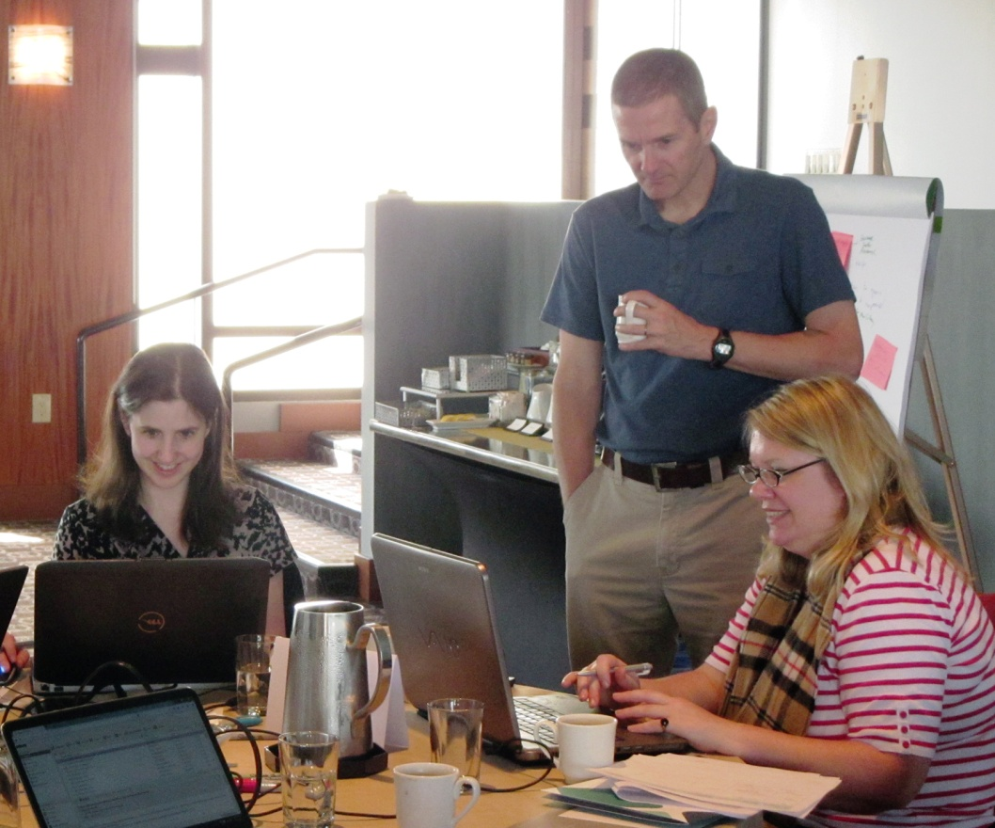
Group: technology
Topic: social media etiquette
Members
Amy Calhoun
Jamie Matczak

Slide 11
Resource sharing rocks!
Nuts and Bolts: Do Your Learning Objectives Match Strategies and Outcomes? (Christine)
NextWeb image source (Stephanie)
Blending Learning Toolkit (Enid)
.story file of Storyline layer construction (Kathleen)
Twitter hashtag #elearning140 for best e-learning tips in 140 characters (Stephanie)
Notes:
Partnership of WJ & IP funded by a grant from IMLS
As part of the SCEC project

Slide 12
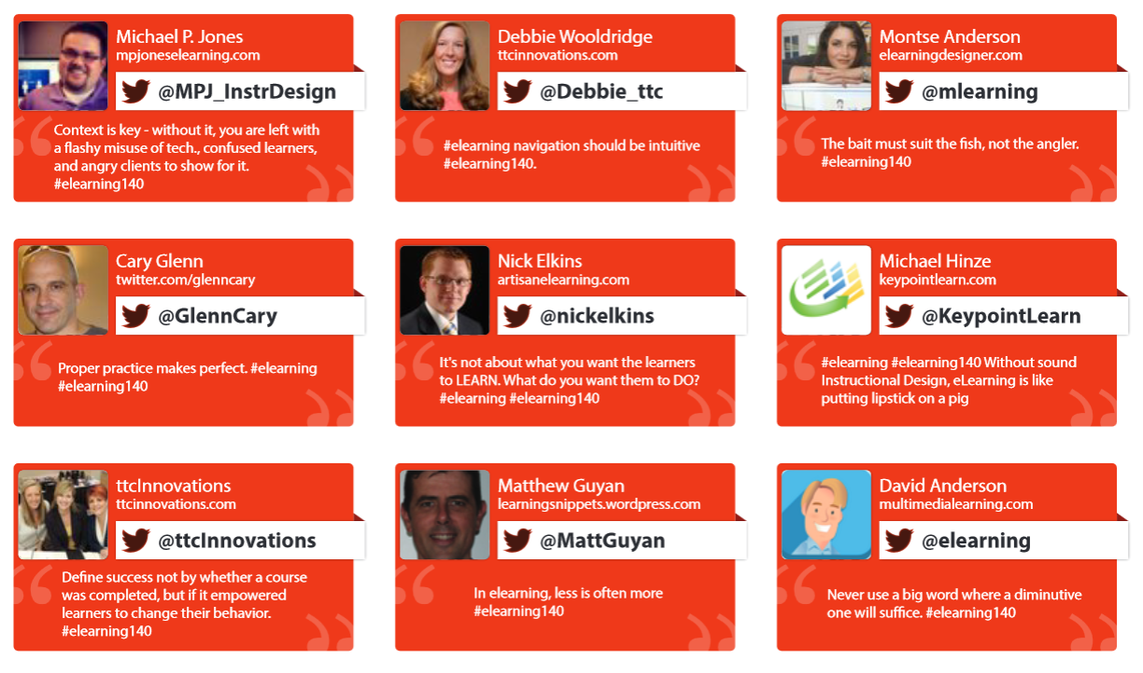
#elearning140
Notes:
Partnership of WJ & IP funded by a grant from IMLS
As part of the SCEC project

Slide 13
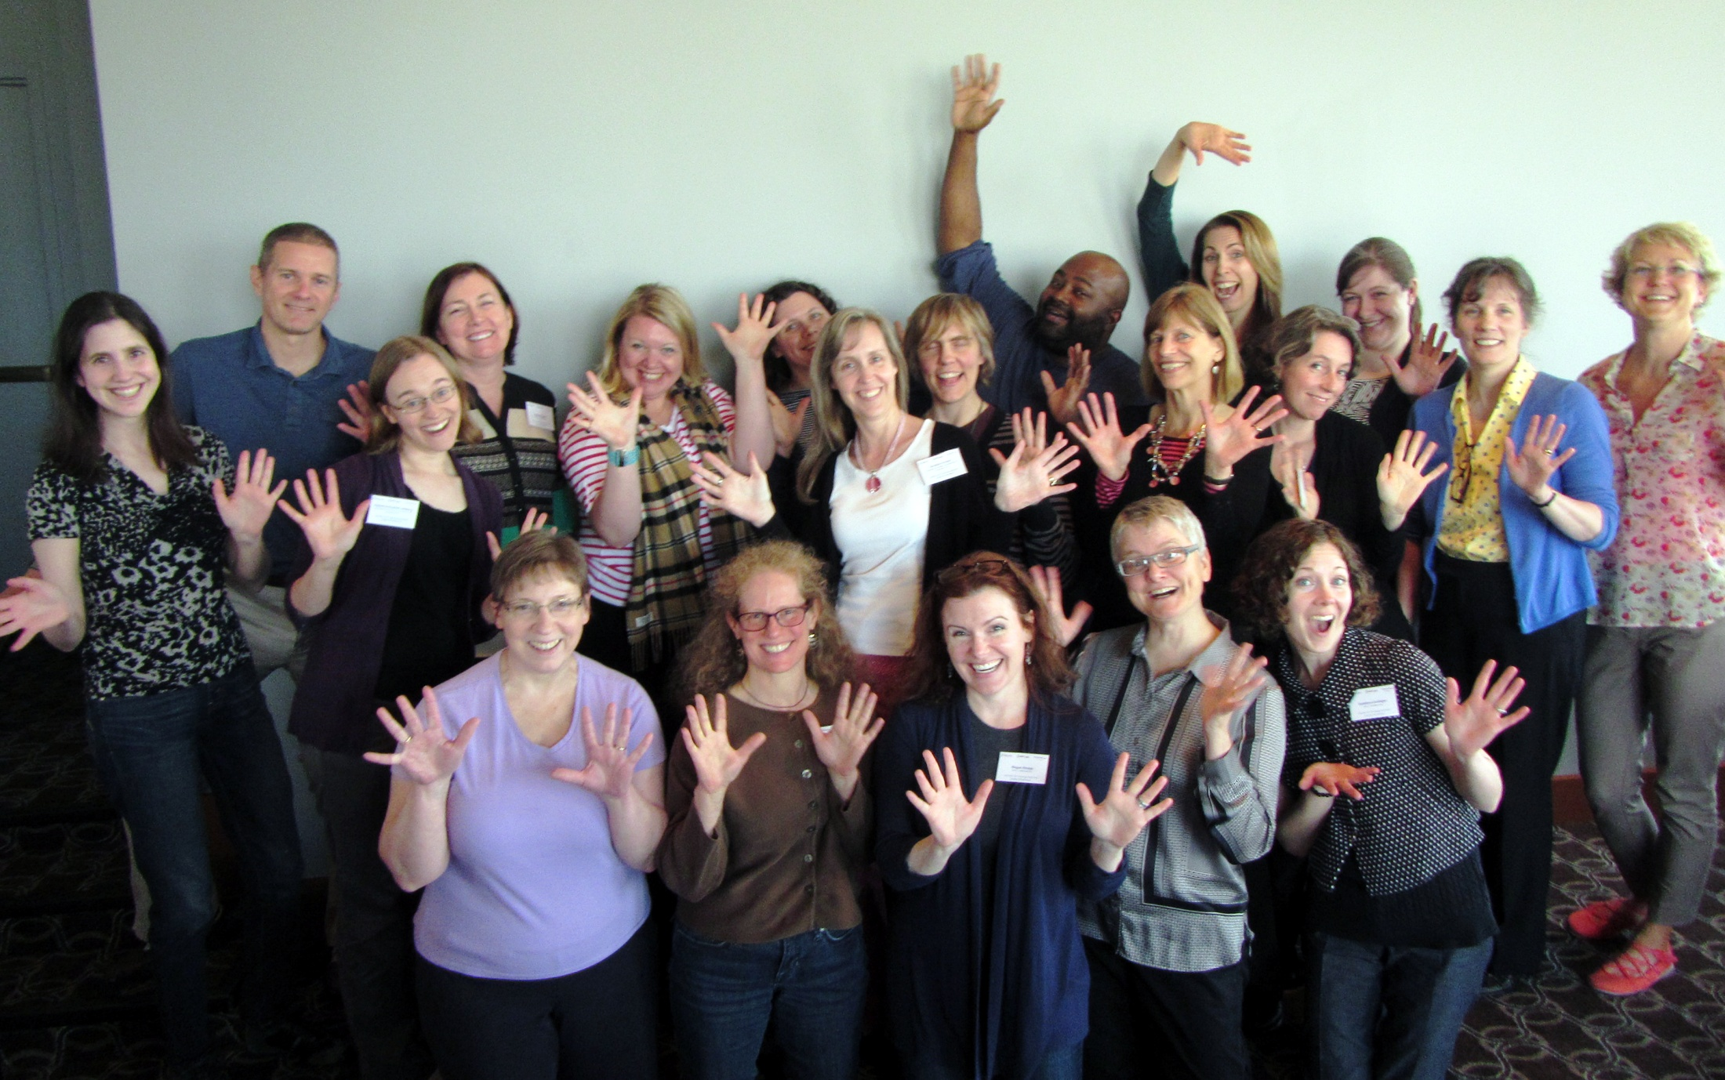
You all are doing awesome work!
Notes:
Image: Seattle from Lower Queen Anne by amidfallenleaves on Flickr
https://www.flickr.com/photos/amidfallenleaves/3401062322

Slide 14
A short tour of Moodle

Slide 15
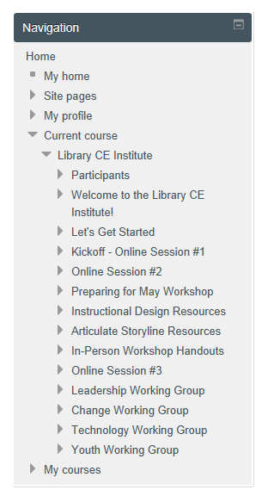
Left Rail - Navigation
Expand or collapse, as needed
Will continue to add modules for sessions, collections of resources, etc.

Slide 16
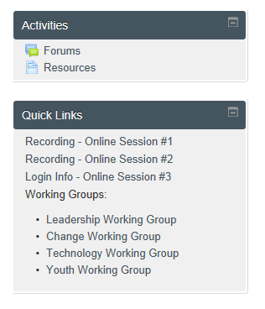
Left Rail – Activities & Quick Links
Quick way to get to list of forums, and all resources (documents, links, etc.)
Quick links will have session recordings, login info, and links to Working Groups.

Slide 17
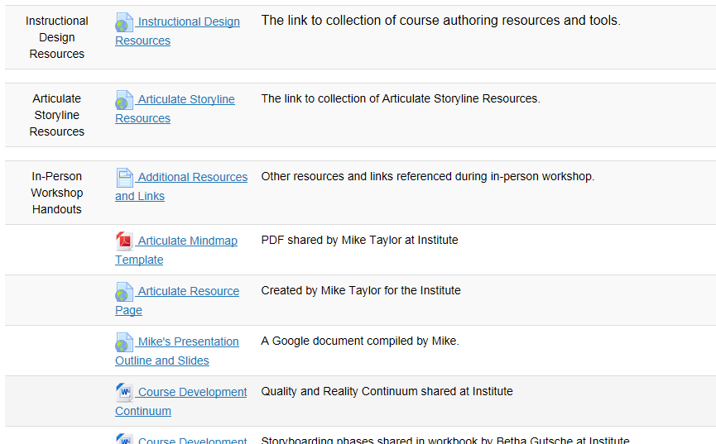
Resources
For a complete list of resources, handouts, links.
Associated with each of the ‘topics’ or ‘modules’ we’ve created as we’ve moved through course.

Slide 18
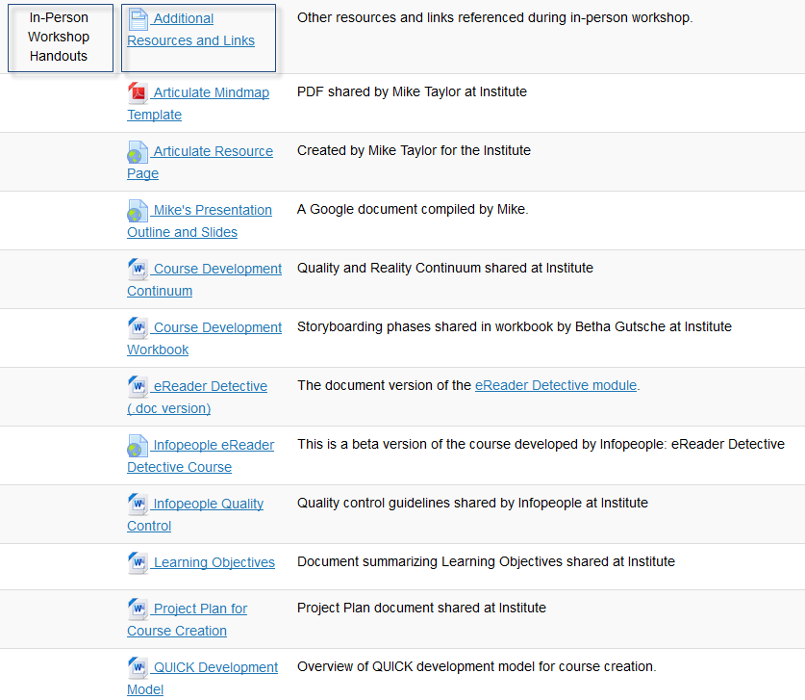
Handouts & Resources from Workshop

Slide 19
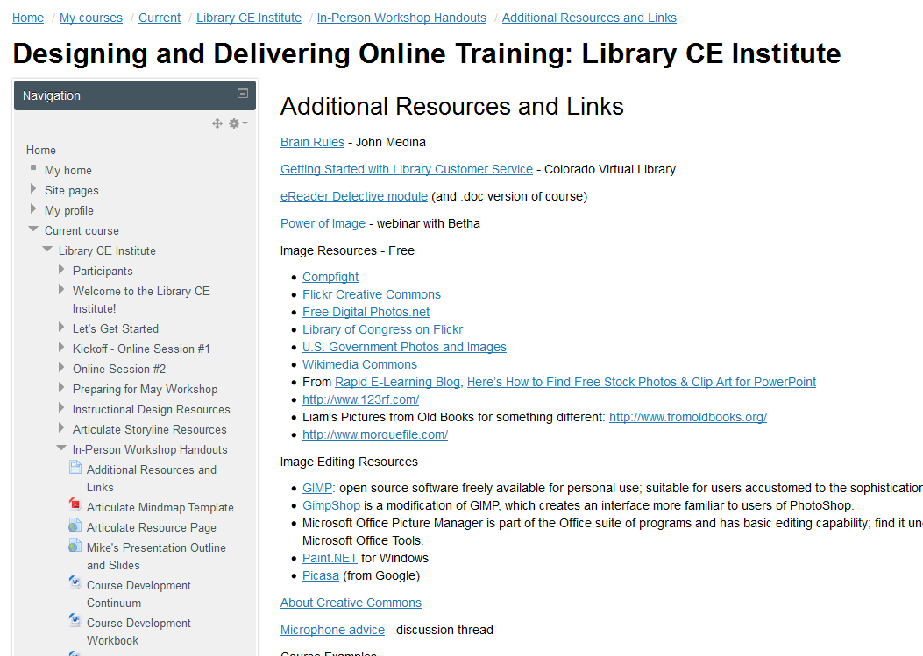
List of Links from Workshop

Slide 20
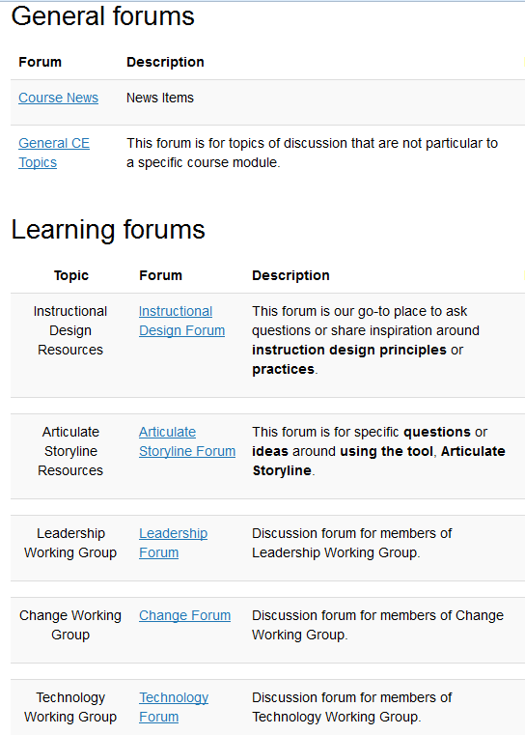
Forums
Best way to get to all forums is left rail, in Activities block
All can view, post, and start new threads in any forum
Welcome to visit other group forums to share ideas on their topic!

Slide 21
Questions and Suggestions
Other areas still ‘muddy’ for you?
Ways you’d like to be able to use our Moodle site?

Slide 22
Next?

Slide 23
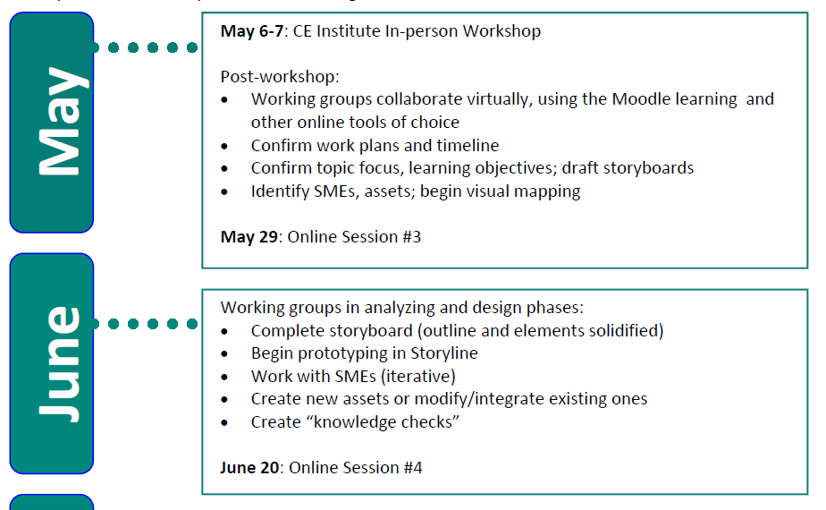
Timeline Check

Slide 24
Online Session #4
Date: Friday, June 20
Time: 1:30 PM ET/10:30 AM PT
90-minute session
Great wheel & Space Needle by Selbe B
Notes:
https://www.flickr.com/photos/stacylynn/7899628332
Great wheel & Space Needle by Selbe B

Slide 25
The Library CE Institute is a partnership of WebJunction and Infopeople It is generously supported by a grant from the Institute of Museum & Library Services (IMLS)
Notes:
Partnership of WJ & IP funded by a grant from IMLS
As part of the SCEC project

