Slide 1
Engaging with Parents and Caregivers – Part 2
Early Literacy Through Adult-Child Activities
Saroj Ghoting, Early Literacy Instructor
Notes:
Now we will look at ways to encourage parents/caregivers to interact with their children during the storytime.

Slide 2
Activities Between
Adults and Their Children
Notes:
Increasing the participation of parents and caregivers with their children increases the likelihood that they will continue the activities that support early literacy at home. It also sends a signal to the children that storytime is important and worth engaging in. It can help children’s focus as well. Parents more likely to do things at home if they have done them in storytime, like retelling stories, doing fingerplays, singing songs, and so forth.
Engaging the adults specifically can keep them off their cell phones and make the whole storytime more interactive and fun.

Slide 3
Cell Phones
Yankee Doodle
Please turn down your cell phones now,
So they will not distract us.
Please join along and sing the songs,
It always helps to practice.
Storytime can help us read.
Storytime is what we need.
Storytime is lots of fun!
Storytime's for everyone.
Mary Binda, Augusta County (VA) Public Library
Notes:
Here's a song to encourage parents/caregivers to participate in the storytime.
Storytime Announcement (Tune: Yankee Doodle)
Please turn down your cell phones now,
So they will not distract us.
Please join along and sing the songs,
It always helps to practice.
Storytime can help us read.
Storytime is what we need.
Storytime is lots of fun!
Storytime's for everyone.
Bring in your own phone and model turning it off.
Early Literacy Aside: Explain: When you participate in our storytime activities, you help to show your children the joy of books, reading, and other language-building activities. They recognize that YOU, the important person in their lives, thinks storytime is important. You help support print motivation, your child's enjoyment of reading, which will later help them stick with learning to read even if it is hard for them.
Submitted by Mary Binda, Augusta County (VA) Public Library

Slide 4
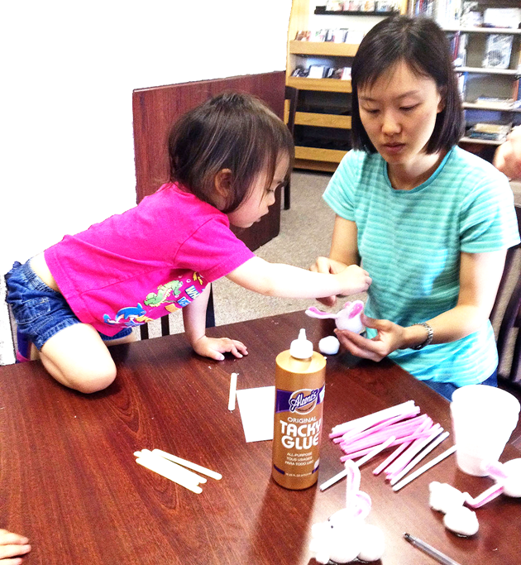
Interactivity
Nametags
Role for adults to play
Talk Time/Pair and Share
Read together time
Craft Time/Activity Time —Experiences!
Photo: Easter Storytime Craft by liberty_hill_public_library on Flickr CC BY-SA 2.0
Notes:
Nametags—if you give to children, then give to adults to signal they are important too.
It is easiest to engage the adults if you give them a specific role to play. This is most easily done with the babies and young toddlers where adults have to be involved because the children cannot do it alone. So, in a baby storytime we are giving instructions to the adults as to what to do with their children as we do an action song, for example.
We can think of ways to give adults a role to play with older children as well.
Here are some ideas from other storytime providers:
Talk Time around the theme—share in pairs
Read together time—it is helpful to give the adults tips on ways to share books that encourage their children’s involvement, such as my relating what is happening to their child’s experience or asking open-ended questions
If you find that when you ask a question, the adults are responding before the children, you can ask a question first of adults, then of the children
Craft/activity time—open ended questions
Photo: Easter Storytime Craft by liberty_hill_public_library on Flickr: https://www.flickr.com/photos/lhpl/6899896788/ CC BY-SA 2.0

Slide 5

TALK
STRIVE for FIVE
Strive for five back-and-forth interactions
Child
1
Adult
2
3
4
5
Adult
1
Child
2
3
4
5
Photo: Give me five; Getty Images
Notes:
When you encourage parents to talk with their children, you can offer the “Strive for Five” technique
Child—picture one who may not be so forthcoming in verbal language
more time to think
uses gestures
David Dickinson, Vanderbilt University
Photo: Give me five; Getty Images: https://www.gettyimages.com/detail/photo/give-me-five-royalty-free-image/603192202

Slide 6

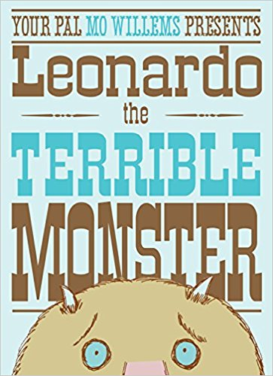
TALK
Talk about things that are scary
Book: Leonardo the Terrible Monster by Mo Willems;: Image: Alien by OpenClipart-Vectors on Pixabay
Notes:
From Natasha Campbell, Multnomah Co (OR) Library
After reading Leonardo the Terrible Monster, ask the children to go sit with their grownup and talk about things that are scary, both the child and the adult sharing. Then ask for something that families have used to help fend off the fears.
Book: Leonardo the Terrible Monster by Mo Willems
Image: Alien by OpenClipart-Vectors on Pixabay https://pixabay.com/en/alien-monster-print-science-fiction-1295482/

Slide 7

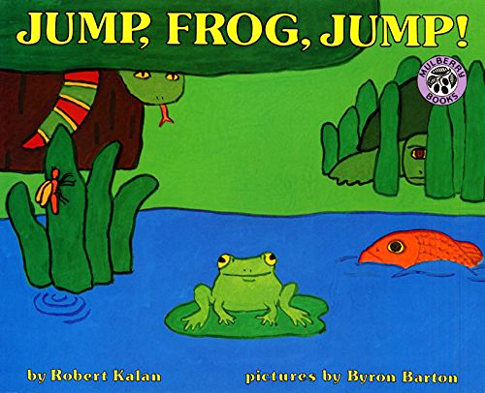
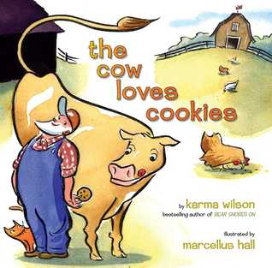
READ
Call and response
Books: The Cow Loves Cookies by Karma Wilson, illustrated by Marcellus Hall
Jump, Frog, Jump by Robert Kalan, illustrated by Byron Barton
Give adults a role to play
Notes:
Jump, Frog, Jump by Robert Kalan, the phrase “jump, frog, jump” is repeated. Do gesture only, one word, two words or the whole phrase. Adults can be encouraged to repeat the phrase as well. Another repeated phrase is “How did the frog get away?” Adults could be asked to say “How did the frog get away?” and the children respond with “Jump, frog, jump,” so it becomes more of a dialog. Lots of smiles all around.
Deema Romer, Grant County (KY) Public Library
Call and response with stories with a lot of repetition. For instance, if reading
The Cow Loves Cookies by Karma Wilson, I might have the grown-ups say, “the cow loves…,” and then the children say, “cookies!”

Slide 8
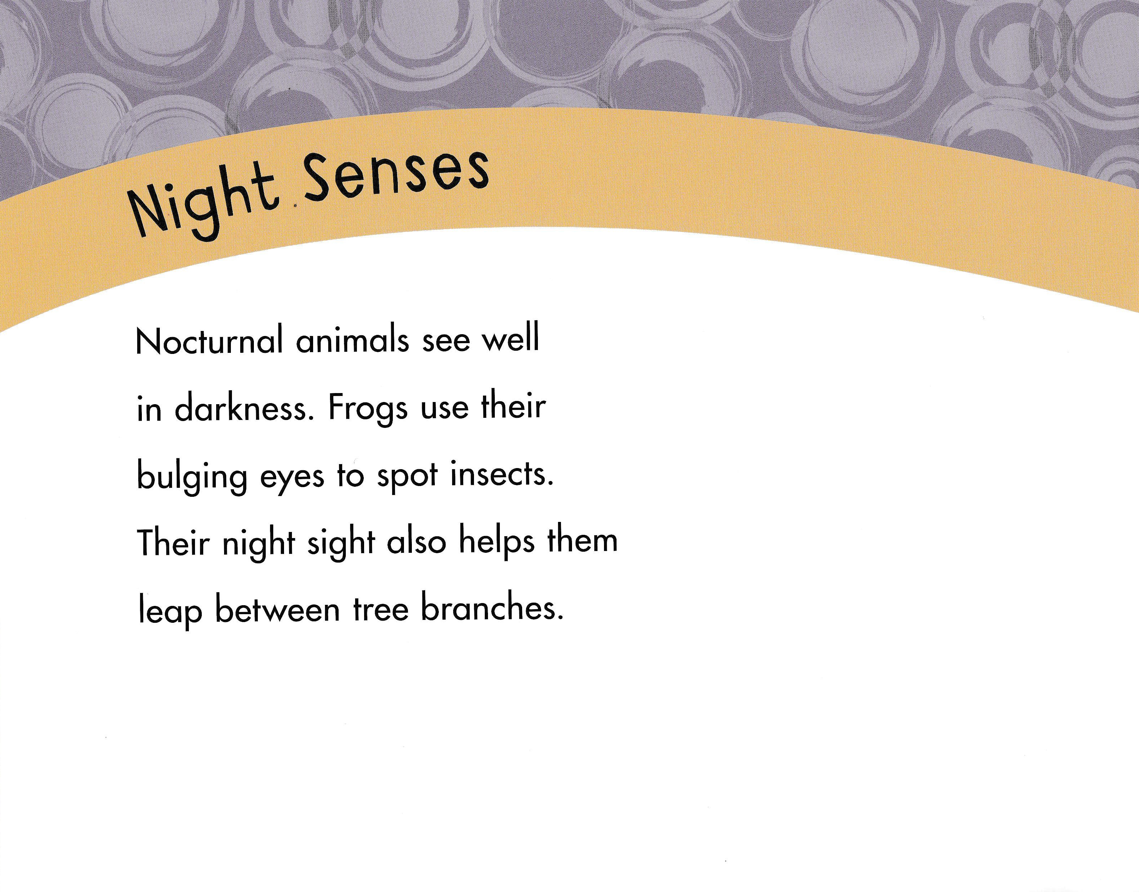
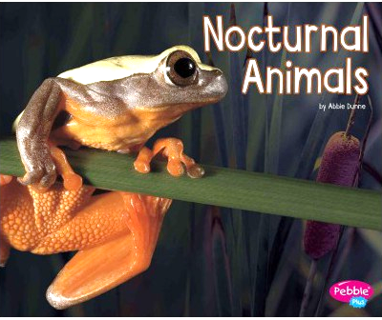
READ
Emphasize keywords
nocturnal
Book: Nocturnal Animals by Abbie Dunne
Notes:
It can also work to emphasize keywords. In a nonfiction book about nocturnal animals, have the children say the important word like, “nocturnal,” every time you point to them and the grown-ups could respond by making a snoring noise.

Slide 9




SING
Two little blackbirds sitting on a hill.
One named Jack; and one named Jill.
Fly away Jack; fly away Jill.
Come back Jack; come back Jill.
Notes:
Explain Two Little Blackbirds --
Can do the motions all together
Then have the adults do with their children; the adult is Jack and the child(ren) are Jill

Slide 10

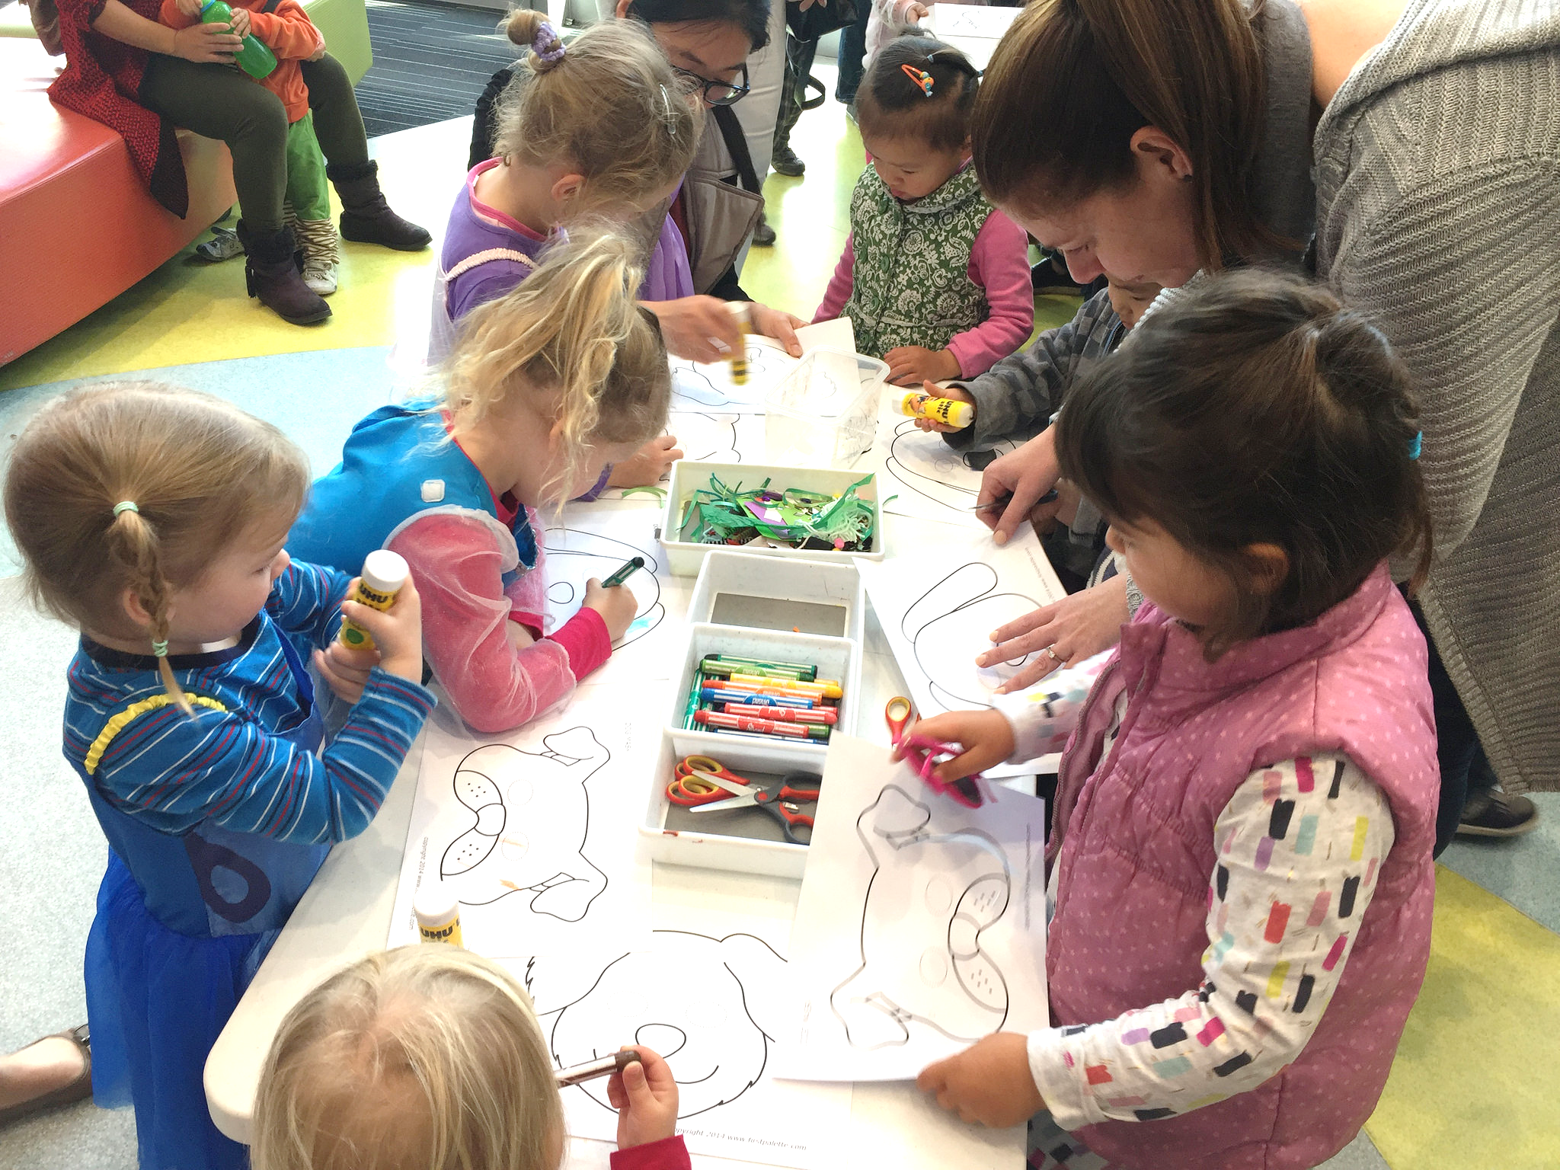
ACTIVITIES
How can you be intentional in making an activity interactive between adults and children?
Photo: IMG_2010 (Craft Time) by Cockburn Libraries on Flickr CC BY-NC-ND 2.0
Notes:
So how have you encouraged interactivity between adults and their children? Or how might you adapt a storytime item to be interactive between the adults and their children? Think about how can you be intentional in making this activity interactive between adults and children.
Now turn to the Learner Guide (adapt as needed) for this topic. Pause the recording and jot down your ideas in the Guide.
When you are done, resume the recording.
Photo: IMG_2010 (Craft Time) by Cockburn Libraries on Flickr: https://www.flickr.com/photos/cockburnlibraries/36333063610/ CC BY-NC-ND 2.0

Slide 11
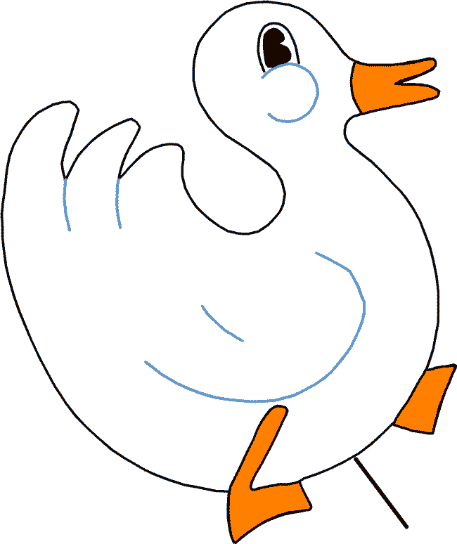

ACTIVITIES
Make crafts interactive between adults and children
Notes:
Craft—enough materials for ADULT and child—why? Perfection and interaction
Adults may not have done these crafts as children
Crafts adapted: duck into puppet with 2 holes facing opposite directions for better interaction as adults and children talk together through their puppets.

Slide 12
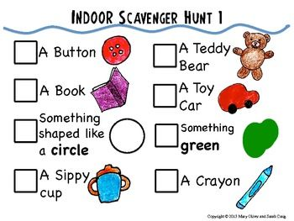
ACTIVITIES
Scavenger
hunt
Notes:
As you look for ways to support interactivity between the adults and their children, you may find that craft times morph into activity time
Crafts → Activities
Scavenger Hunt
Activity time: Play Simon Says using actions from book you read
Adults and children act out a story or rhyme
Cards to play concentration—matching rhyming words or words that start with same sound
Think how you might turn your craft or activity time into experiences, like block play. Experiences give that sense of richness, sharing a common happening, and offer opportunities for rich language development, even if they are not taking home a craft.

Slide 13

YOU make a difference
Photo: Father and Son reading together; Getty Images
Notes:
You are critical in helping parents and caregivers become more aware of ways they can support early literacy and their children’s language development.
Both explaining the why, how it makes a difference, AND ways to keep it fun are important in helping children become readers as they grow.

Slide 14





Acknowledgements
This project is funded by OCLC and by a grant from the Institute of Museum and Library Services, RE-95-17-0085-17
With appreciation for our Content Partners:
  The Campaign for Grade-Level Reading
  Project Outcome
  Saroj Ghoting
Notes:
This concludes the presentation on providing early literacy activities that parents and caregivers can do with their children at storytimes.

