Slide 1
Engaging with Parents and Caregivers – Part 1
Early Literacy Begins at Home
Saroj Ghoting, Early Literacy Instructor
Notes:
This presentation is on engaging with parents and caregivers through early literacy tips at storytime.
Children are with their parents/caregivers every day. We can help them support their children’s language and literacy development.

Slide 2
Parents & caregivers play a primary role
Because they:
are their children’s first teacher
know their children best
take advantage of opportunities throughout the day
Photo: Father reading to son by Rene Asmussen on Pexels
Small interactions add up to a BIG difference
Notes:
Early literacy development starts at birth
Small interactions throughout the day add up to make a big difference
Parents are their children’s first teacher. Children imitate adults and learn from them.
Photo: Father reading book to son by Rene Asmussen on Pexels: https://www.pexels.com/photo/adult-baby-book-boy-626631/

Slide 3
Why engage with them at storytime?
You help them engage with their children
You educate parents and caregivers about the importance of early literacy development
You provide tips for activities they can do at home
Photo: Rhythm Babies by Pioneer Library System on Flickr CC BY-NC-ND 2.0
All adults can supercharge children’s early literacy
Notes:
It is important to engage parents and share early literacy information with them. If a child comes to storytime and then goes home to an environment that is not language rich, then the intervention of storytime is often not enough or intense enough to develop early literacy.
Storytimes are valuable in and of themselves. But to supercharge their value, we must help the adults continue to support early literacy at home.
Expectations when children enter school are quite different from a generation ago.
In addition, parents who did not go to school in the United States may not be familiar with school expectations. We can help prepare them.
One of the strengths of storytimes is that we support early literacy with enjoyable activities, and model this for the adults.
Photo: Rhythm Babies by Pioneer Library System on Flickr: https://www.flickr.com/photos/jsyk/5079334908/ CC BY-NC-ND 2.0

Slide 4
Engagement Built on Trust
It’s about building relationships with parents and caregivers as well as with children
Photo: DSCF0743 by JBLM MWR on Flickr CC BY 2.0
Notes:
Just as with children, adults will be more engaged when we build relationships. This is an important and evolving process, to build rapport and trust.
When we listen to parents and caregivers, we learn their perspectives and find common ground for sharing experiences and knowledge.
Both we and the parents and caregivers can share ideas on ways to support early literacy at home.

Slide 5
Early Literacy Tips for Parents and Caregivers
Notes:
In this recording, we will focus on offering early literacy tips to show how what we are doing supports early literacy and later reading.
You have now gotten a good sense of interactivity and intentionality
As you are becoming intentional around each of the early literacy components using the Early Literacy Planning Tool Worksheets, you have been noticing connections between books you use in storytimes and each early literacy component
One important benefit of becoming intentional, recognizing the connection between storytime activities, early literacy, and later reading, is that we can also share this information by adding an early literacy tip to parents and caregivers.
Parent evaluations of storytimes that included early literacy tips found that parents are more likely to continue early literacy activities at home for two reasons:
the storytime presenter made it look fun and doable
they now understood the connection between the activity and literacy which motivated them to keep it going

Slide 6
What is an Early Literacy Tip?
A way to share connections between storytime activities, early literacy, and later reading ability
Photo: Mother and son by Nicholas Githiri on Pexels
Notes:
So what is an early literacy tip anyway?
A couple of sentences explaining the connections between what you are doing that supports early literacy which leads to later reading
15 – 20 seconds
Photo: Mother and son by Nicholas Githiri on Pexels: https://www.pexels.com/photo/tilt-shift-lens-photography-of-woman-wearing-red-sweater-and-white-skirt-while-holding-a-boy-wearing-white-and-black-crew-neck-shirt-and-blue-denim-short-1027931/

Slide 7
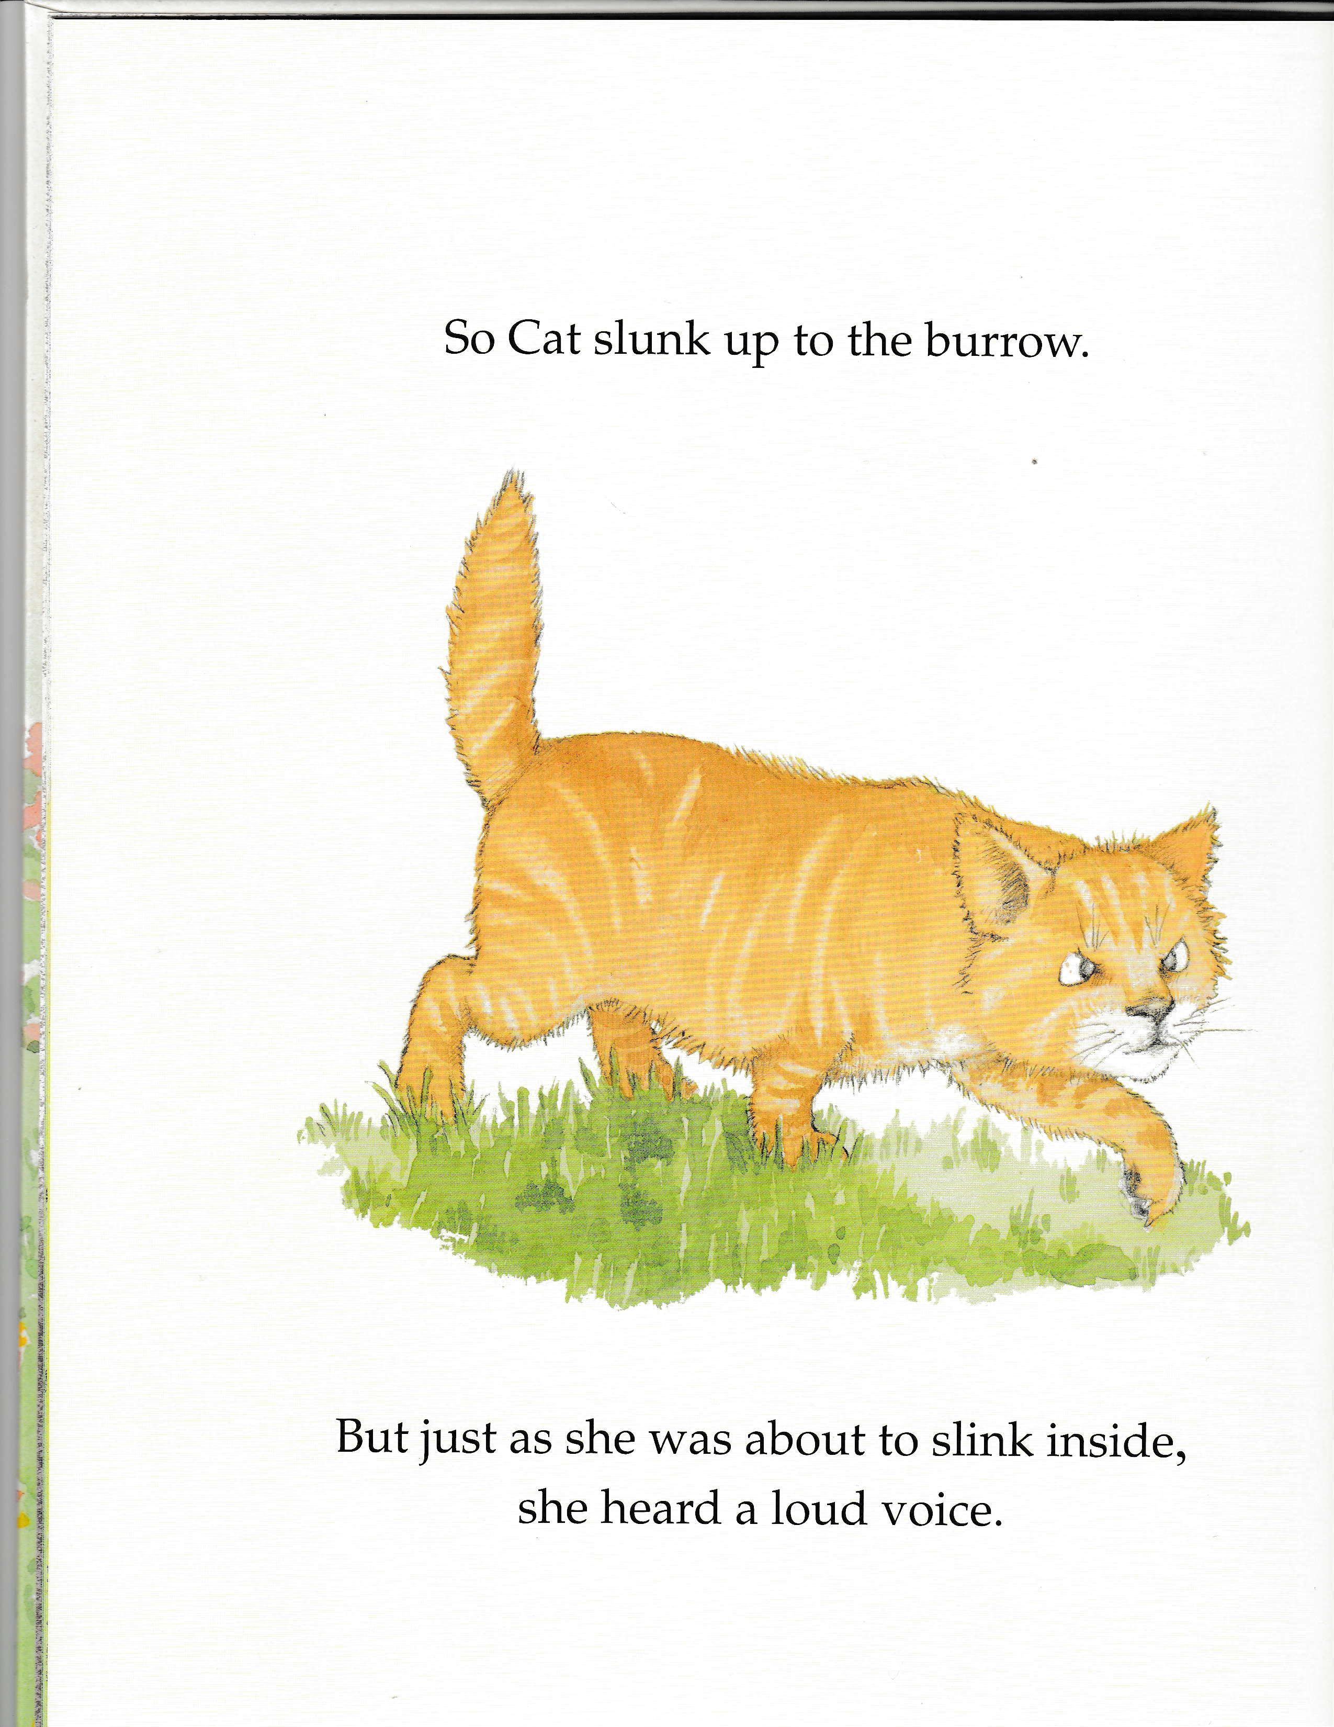
Being Intentional Leads to Tips
Parent Tip
When we explain an unfamiliar word, we help children learn what it means.
This helps them know more words which will later help them understand what they read .
Notes:
What might that look like?
Let’s say I was reading The Giant Jumperee by Julia Donaldson and Helen Oxenbury.
“So Cat slunk up to the burrow, the hole where rabbit lives. But just as she was about to slink inside, she heard a loud sound.”
Slink (or slunk) means walking smoothly and quietly, maybe a little sneaky.
So Cat slunk up to the burrow. He walked very quietly, a little sneakily.
My tip to the parents/caregivers would be something like this—read slide.

Slide 8
Connect the Early Literacy Dots
You connect the dots to show how an activity or practice supports an early literacy component and reading skill.
Activity Examples
Guess rhyming word
Clap syllables
Repeat a phrase
Act out a story
Early Literacy Component
Phonological Awareness
Print Concepts
Letter Knowledge
Vocabulary
Vocabulary
Background Knowledge
Reading Skill
Decoding: recognizing and sounding out words
Comprehension: understanding
Practice
Talking
Singing
Reading
Writing
Playing
Notes:
So, when we say an early literacy tip, we want to connect the dots for parents and caregivers just as we are being intentional about connecting the dots when we are being intentional for the children.
Read box
Your tips don’t need to get this technical in your explanations to adults – just know that this is the backbone of how you are helping to prepare children to learn to read.
So, you know that having children clap syllables supports phonological awareness which leads to helping them decode words. You could then adapt your knowledge to this tip:
When we clap syllables, it helps children hear the smaller sounds in words, which later helps them sound out words when they learn to read.
Here is another example: Let’s say you have read a factual book, or even a couple of pages of a factual book. You could say to the adults:
When we share factual information with children they are learning about the world. This builds their background knowledge which will later help them understand what they will read.
Connect the dots!
It may take some time before you feel comfortable sharing your early literacy knowledge with parents and caregivers. It’s okay to start with what feels natural and doable and then build to tips that are more detailed, making the connection for how adults can build their children’s early literacy behaviors and why it’s important for later reading.
Adding early literacy tips does not take away from the enjoyment of sharing books and language activities. They enhance the storytime experience.

Slide 9
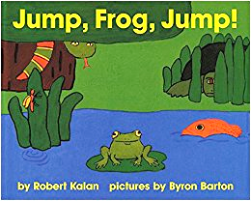
The “When we…” Format
“When we [insert activity], we help children _______. This helps them [explain skill] which will later help them [choose one: sound out words or understand what they read when they learn to read].
Adults, when we point to the text in the title, we help children understand that it is the text we are reading, not the pictures. This helps them focus on the text, which will make it easier for them when they learn to read.
Book: Jump, Frog, Jump! by Robert Kalan, illustrated by Byron Barton
Notes:
Some people are concerned about sounding condescending.
Might try the When we format
Read tip, then point out formula
If you want, you can add that focusing on the text develops print concepts.
Start with one tip—the example tip where you are demonstrating something
As you become more intentional it is easier to articulate the connections for the adults.

Slide 10
The 3 Es of Timing Your Tips
at the beginning of storytime, tell adults what you will do to emphasize an early literacy component
during storytime, demonstrate how to emphasize the early literacy component and tell adults what your are doing
at the end, share ways that adults can emphasize the early literacy component at home
Explain
Example
Empower
Notes:
You can deliver tips at different points in your storytime.
At the beginning of the storytime, you may choose to briefly explain to the adults what early literacy component you will focus on and what to listen for.
When you demonstrate the example during storytime, talk directly to the adults about what you just did.
At the end of the storytime, you may offer ideas for parents and caregivers to empower them to keep early literacy going after leaving storytime.
you don’t want to overwhelm the adults with early literacy information.
If you are giving more than one tip in a storytime, I suggest it be around the same early literacy component. The adults come away with a stronger understanding.
So, if you gave an example tip around vocabulary, and then gave an empower tip at the end of your storytime, then the empower tip would also be about vocabulary.
In supercharged storytime, there is no “dosage” so to speak. Start with one tip and see where it takes you.

Slide 11
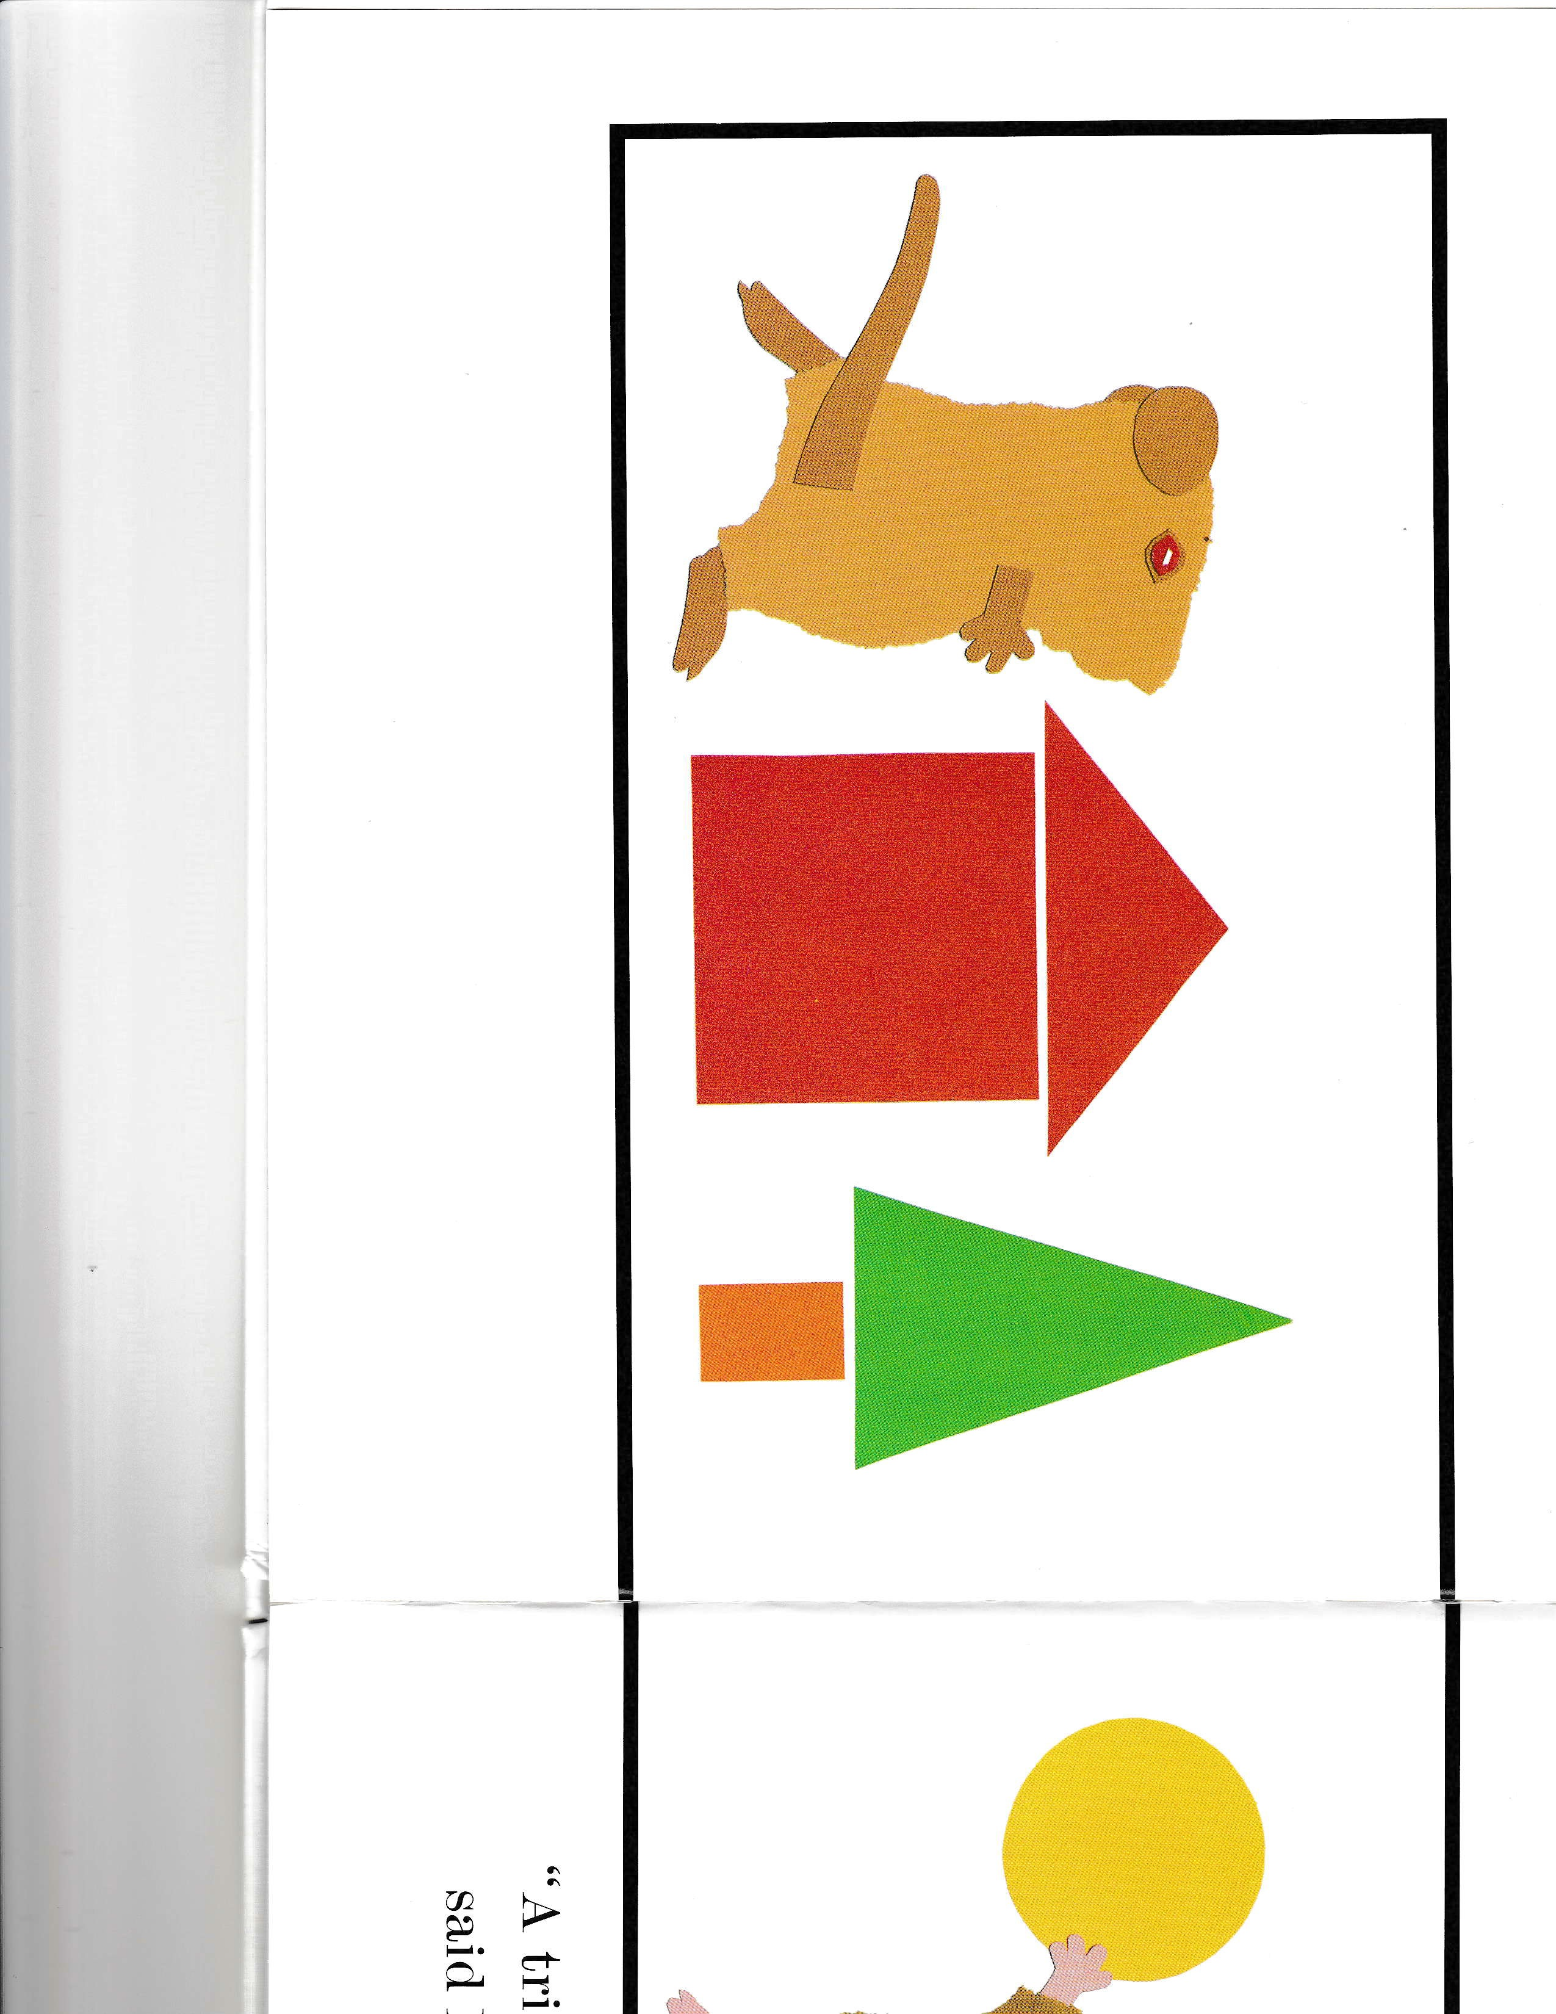
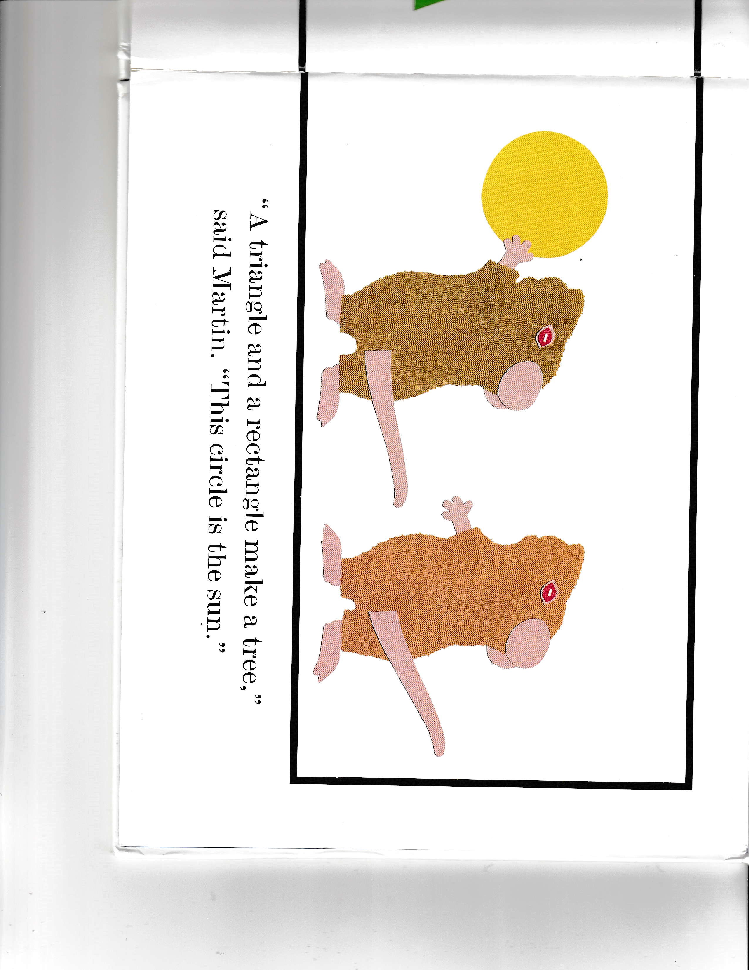
READ
Talk about shapes
Parent Tip
Adults, our next book is Mouse Shapes. I take time to talk about the shapes in the pictures. Talking about shapes helps children recognize letters because they will identify letters by their shapes!
Mouse Shapes by Ellen Walsh
Notes:
I’ll say some tips now to help you get the feel.
Adults, our next book is Mouse Shapes. I’ll take time to talk about the shapes in the pictures. Talking about shapes helps children recognize letters because when they learn to read, children identify letters by their shapes!
Mouse Shapes by Ellen Walsh

Slide 12
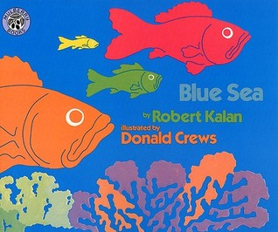
ACTIVITIES
Parent Tip
Adults, I have a handout here of Blue Sea. You can cut out the fish and holes of different sizes and retell the story. Retelling stories helps children understand the story and how stories work which will later help them understand what they read.
Enjoy your time sharing and retelling stories together.
Book: Blue Sea by Robert Kalan; illustrated by Donald Crews
Notes:
Here is an empower tip, something they can do at home around retelling stories.
Read the tip.
You can find the pattern for the handout in the Additional Resources – Module 2 document
Book: Blue Sea by Robert Kalan

Slide 13
ACTIVITIES
Parent Tip
When we talk about words for spatial relationships like between, below, above, we are building children’s vocabulary and helping them learn these concepts.
This will help them later understand what they read.
Flannel board activity
Notes:
Here is a tip with a flannel board activity.
I put up 2 triangles on the flannel board. Each child gets a circle and puts it up. As they put it up, I describe where it is.
Oh, Maya, you put your yellow circle BETWEEN the two triangles. Nathan, you put your gray circle BELOW the red triangle.
You could say this tip as a child is coming up to put the circle on the flannel board.
Read tip.
Many of you do matching activities on flannel boards. They have to notice visual similarities and differences—leading to letter knowledge!

Slide 14
But how do you feel about sharing early literacy tips?
It feels/will feel awkward and not fun
Interrupting my storytime will lose kids’ attention
I don’t want to sound “teachy” or condescending
I’m not an early literacy expert
Will they even listen to me?
I’ve tried it and it didn’t go well
I’m excited to try it but I’m shy or nervous
I already do this in my storytimes
Other
Check all that apply
Notes:
Whether you are a new or seasoned storytime provider, you may be hesitant around sharing early literacy tips with adults. Think about how you feel about doing this.
Find this checklist in the Learner Guide (adapt as needed) for this topic, pause the recording, and check all the boxes that apply. If you have other feelings not shown here, make a note of them.
When you are done, resume the recording.

Slide 15
“Sometimes I forget to share the tip I prepared!
Notes:
You are not alone! Here’s what some storytime providers checked off. (adapt as needed)
Notice that is quite a range--quite a few are already sharing tips and getting increasingly confident with how to make it work well and others are wondering what it might be like to say tips.

Slide 16
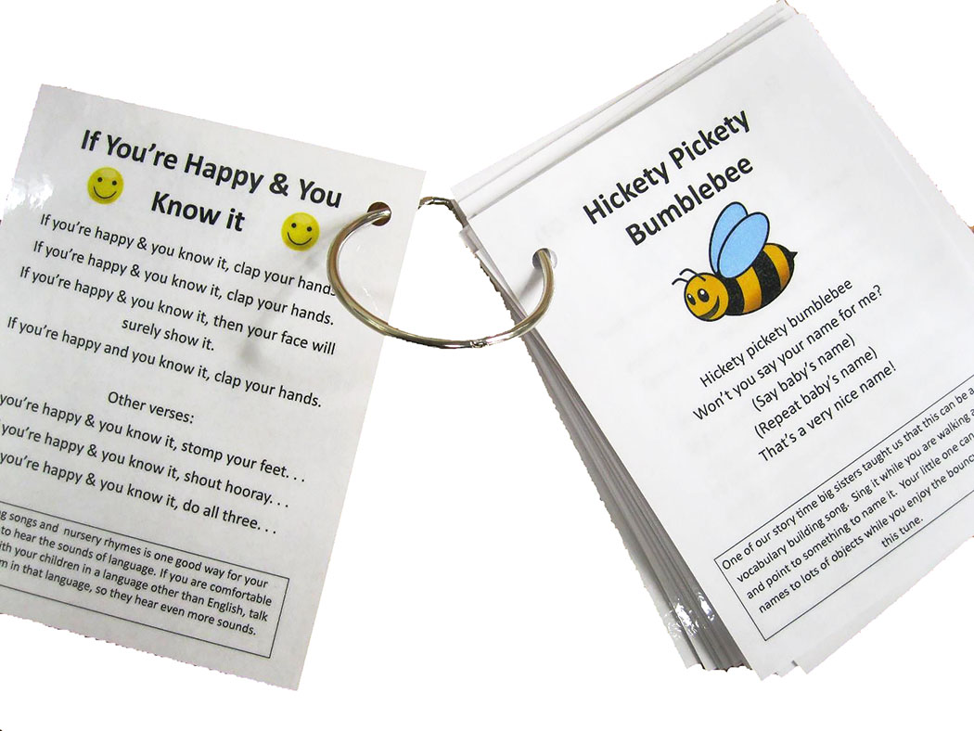
…a few general strategies
Establish a routine
Use signals
Host puppet
Use flipchart, white board or Post-its
Offer “Fun Facts”
Create handouts or parent tip sheets
Photo: Parent Tips by Mari Nowitz; used with permission:
Notes:
Planning the tip: Write it, say what you write, put it in conversational wording, then write what you said. Remember we all say things in different ways. Just connect the dots.
Have a routine
Signal—song (skip to my lou tune)
Sandwich it—between two repetitions of a song, for example
Sing, talk, read, write, play
Sing, talk, read, write, play
Sing, talk, read, write, play
Growing readers day by day.
Believe it or not, what we did will one day help your child learn to read. . . .
Here’s a fun fact . . .
Use something you already do to include a tip, like a host puppet
In your Learner Guide for this topic, there is a link to a video that demonstrates how one storytime provider uses a puppet to talk to the adults.
Connect it to an action, as the children are practicing the action
As you are turning to get your next book, or putting your book away
Post-it on the book or item
Flipchart—say it also
Handout—something to do/make and add the tip to the handout as well as say the tip
Handout becomes a support to you

Slide 17
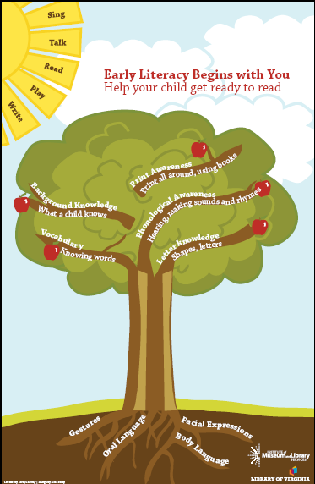
Early Literacy Begins at Home
Print the poster so you have a visual aid as you say your early literacy tips
http://www.earlylit.net/s/treeposter-y3az.pdf
Notes:
You are able to print out a poster with the early literacy components and the five practices, in the Additional Resources – Module 2 document
Sometimes it is helpful to have a visual like this to use as an aid when you say your early literacy tips.
I printed out and laminated an apple blossom and put tape on the back. I stick the apple blossom beside whichever early literacy component I am highlighting that day.

Slide 18
Successful Communication
You don’t need to be an expert –you have valuable early literacy information to share
You’re both acknowledging what they are doing and giving ideas to support early literacy
You can do this and keep it fluid and fun
Mari Nowitz says:
“I love to tell parents ‘this is great for your kids’ brains!’ ”
Photo: Mari Nowitz doing storytime; used with permission
Notes:
It may take a while to feel comfortable sharing early literacy tips with adults.
You will be listening to a presentation by Mari Nowitz, one of the VIEWS2 study participants, on getting used to sharing early literacy information with adults.
It is fine to start with one tip. As you become more intentional, it is easier to articulate the connections for the adults.
You may feel that parents who come to storytime already know the information you are sharing. Some do, some don’t. Some may know some tips and not others. Remember, those who already knew a particular tip are getting a pat on the back, which is a good thing! And everyone is realizing that the library is a good place to come to get information on early literacy.
I have noticed that with supercharged storytimes, as we become more interactive and as we share information with parents and caregivers, our role shifts from being an entertainer/presenter to being more of a facilitator. That doesn’t mean we can’t be entertaining though!

Slide 19
Building on what you already enjoy doing in storytimes!
Photo: Tulsa Shock Storytime, Jennifer Lacy, Glory Johnson; Tulsa City-County Library on Flickr CC BY-NC-ND 2.0
Notes:
You will be looking back at the Early Literacy Planning Tool Worksheets. By filling in early literacy tips, you will see how you are building on what you already enjoy doing in your own storytimes.
This approach keeps your storytimes fun and invigorating as you supercharge them.

Slide 20
Informal Learning @ the Library
We support critical early literacy development through the joy of books, reading and language play
Learning and FUN go together
Photo: Story Time FUN @ Mendenhall Library by CMRLS Photos on Flickr CC BY-NC-ND 2.0
Notes:
We emphasize the joy of books, reading and language play.
Even though we are making connections between what we do in storytimes and early literacy skills that are taught and evaluated in formal education settings, we do not become formal learning environments.
Rather, we show how storytimes can support children’s early literacy development through joyful activities and informal learning.
Photo: Story Time FUN @ Mendenhall Library by CMRLS Photos on Flickr: https://www.flickr.com/photos/cmrlsphoto/7487974940/in/photostream/ CC BY-NC-ND 2.0

Slide 21
Acknowledgements
This project is funded by OCLC and by a grant from the Institute of Museum and Library Services, RE-95-17-0085-17
With appreciation for our Content Partners:
The Campaign for Grade-Level Reading
Project Outcome
Saroj Ghoting
Notes:
This concludes the presentation on engaging with parents and caregivers in storytimes.

