Slide 1
Background Knowledge Part 1
Child’s Prior Knowledge About the World
Notes:
Welcome to Supercharged Storytimes
In this module, we look at background knowledge, last but not least early literacy component.

Slide 2
Background Knowledge is …
a child’s knowledge about the world
3 aspects:
Conceptual thinking ⎯abstract thinking
Content knowledge ⎯facts and information on a variety of topics
Book/story knowledge ⎯understanding the purpose of books and structure of stories, and enjoying them
Notes:
Background knowledge is what children know about the world before they enter school. World knowledge.
Although It helps them to understand the meaning of words, it is deeper and broader than vocabulary. The experiences that children bring to school influence their background knowledge. Background knowledge is critical to their understanding of what they read.
It is broad and includes three subtopics.
Conceptual thinking: abstract thinking
Content knowledge: facts and information on a variety of topics
Book/story knowledge: purposes of books
How stories work
Narrative skills—retell stories and events
Print motivation—enjoyment around books and reading

Slide 3

Why is it important?
The more children know about the world, the easier it is for them to understand what they will read
Photo: The wonder of a book by Ben White on Unsplash
Notes:
Research notes: the more a person knows, the easier it is to learn new things in each step of a three-stage process: as you take in new information, as you think about the information, and as the information is stored in memory
Children bring their knowledge of the world around them to interpret the words they are decoding in order to make sense of what they are reading.
Photo: The wonder of a book by Ben White on Unsplash: https://unsplash.com/photos/qDY9ahp0Mto

Slide 4
Conceptual Thinking
The ability to think abstractly
Notes:
Let’s look first at conceptual thinking, the ability to think abstractly.

Slide 5


There’s a lot to it
Thinking abstractly beyond what is in front of you
  Understand symbols, ability to pretend
  and imagine, talk about things not seen
  (like truth)
The construction of thought processes
  Remembering, problem-solving, decision-making
Observing objects and their relationships
  Ability to sort and sequence, put things/events in order, recognize cause and effect
Notes:
Conceptual thinking includes knowing concepts like colors, size, opposites.
However, it is broader that that. It is the ability to think abstractly, about things that are not immediately in front of you.
Symbolic thinking, representational thinking—progression: sippy cup, block, no symbol
Ability to pretend and imagine
Ability to understand ideas—truth, fairness, responsibility
It is the construction of thought processes, including remembering, problem solving, and decision-making.
For an infant, the beginning is object permanence—the concept that an object exists even if you can’t see it
You need memory to then notice patterns, to learn from past experiences for problem solving—not 2 + 4 = 6, but how can I reach my toy?
Make connections between experiences and knowledge—text to self, text to text, text to world
It is observing objects and their relationships.
Infant is feeling objects, tasting them, manipulating them to see what they do
Toddlers and two can sort by one or two characteristics—color or size, for example
Preschoolers can sort by 3 or more characteristics including the function of the object, not just how it looks. So, things that cut, gardening vs. cooking
Ability to sequence, put things/events in order—concrete (sock/shoe) to telling a story
Ability to predict and hypothesize
Recognizing cause and effect—the younger the child, the more concrete and immediate the effect must be to the cause
Images:
Dragon by ArtsyBee on Pixabay: https://pixabay.com/en/asian-dragon-scary-fire-mythical-1527234/
Dominoes by 3dman_eu on Pixabay: https://pixabay.com/en/mikado-domino-stones-pay-steinchen-1013877/

Slide 6

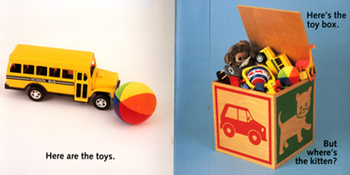
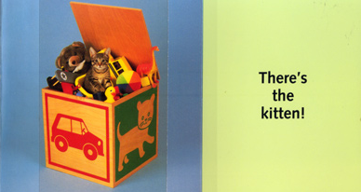
Birth-18 months
For birth to 18 months
Infants
Show stark contrast between
pictures and background colors
Play games with like peek-a-boo
Book: Where’s the Kitten? by Cheryl Christian; courtesy of Starbright Books
Notes:
Flap books are a kind of peek-a-boo to support object permanence
Where’s the Kitten? by Cheryl Christian, Star Bright Books, 1996

Slide 7

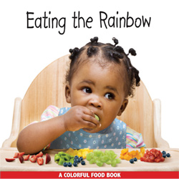
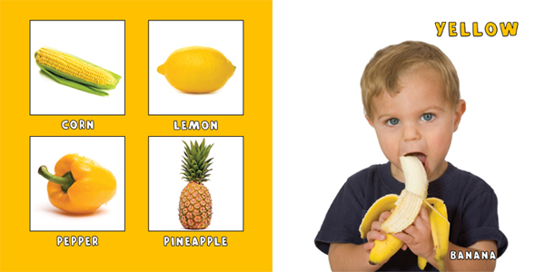
Birth-18 months
For birth to 18 months
Toddlers
Read books about the world around them
Use concepts like “all gone!,” colors, size, opposites
Books: Eating the Rainbow; All Gone!; courtesy of Starbright Books
Notes:
The concept of “all gone” is one infants and toddlers can understand. This book shows cereal, juice, and cookies and then for each one, all gone!
Books that look at color support conceptual thinking.
Having the real item, a lemon or banana, to show that the picture represents the real item also supports conceptual thinking.
Eating the Rainbow, Star Bright Books, 2009.
Begin Smart All Gone!

Slide 8
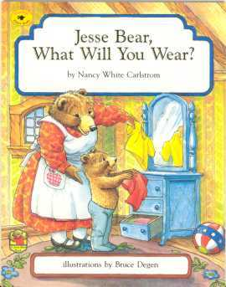

18-36 months
For 18 – 36 months
Encouraging children to talk about:
the pictures in books
concepts: size, color, sequence
experiences related to the book, past and future
Asking them to draw a picture about the book and tell you about it
Sequence of day
Connect the book to the world
Books: Jesse Bear, What Will You Wear? by Nancy White Carlstrom; Big Bigger Biggest by Harriet Ziefert
Notes:
Relating the pictures in a book, and what is happening in the book, to the child’s world develops comprehension
We can do this in a number of ways, as you can see here.
Encouraging the child to talk about the pictures. You can do either or both of these—have the children talk about their experiences, or if they do not have that much language, then you can offer the words to do so.
Having children child draw a picture about the book and tell you about it allows them to be in charge of what was important to them, so you are following the child’s lead, building on what they know and adding to it.
Jesse Bear, What Will You Wear? by Nancy White Carlstrom, Aladdin, 1996
Big Bigger, Biggest—size

Slide 9

For 3 – 5 years
3-5 years
Use everything you would do with 18-36 months plus:
Encourage children to use their
imaginations while telling you stories
Image: Book Dreams by Comfreak on Pixabay
Notes:
Read slide
Make up a different ending
Image: Book Dreams by Comfreak on Pixabay: https://pixabay.com/en/narrative-history-dream-tell-794978/

Slide 10
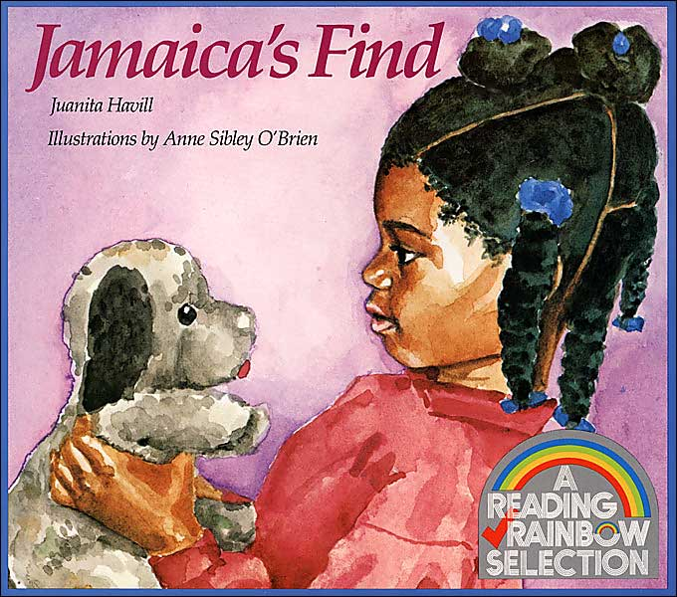

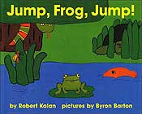
For 3 – 5 years
3-5 years
Read books that:
reflect their experiences
expose them to new experiences
encourage talking about ideas
Read books with:
specific sequence of events
cumulative actions or phrases
Books: Jamaica’s Find by Juanita Havill, illus by Anne Sibley O’Brien; Flight School by Lita Judge;
Jump, Frog, Jump! By Robert Kalan, illus by Byron Barton
Notes:
Jamaica’s Find—honest, returning a lost stuffed animal puppy dog, talk about ideas
Reflect their experiences or expose them to new experiences
Flight School—perseverance and problem solving
Jump, Frog, Jump by Robert Kalan, Greenwillow, 1981.
This is the snake that dropped from a branch
and swallowed the fish . . .
Cumulative tales support sequencing and prediction

Slide 11
Content Knowledge
Facts and information on
a variety of topics
Notes:
Let’s look now at the second area of background knowledge, content knowledge.

Slide 12
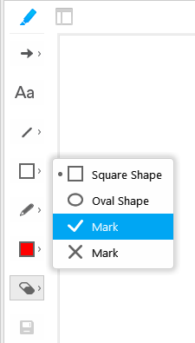
Annotation Tools
Find the grey marker pen in top left corner of the presentation screen.
Click to open the tool buttons in a column on the
left side; the marker pen will turn blue.
Check mark
Click on square shape, half-way down.
Use the drop-down menu and
choose the check mark.
Click on slide to indicate choice.
Notes:
Adapt as desired

Slide 13
Factual Books vs Story Books
Conversation with children is more cognitively demanding when adults read:
Parents allow children to talk twice as much about the content of:
When parents read this type of book, they are more interruptible:
Factual
Story
Factual
Story
Factual
Story
Notes:
As we begin to explore more information around content knowledge, or the facts and information on a variety of topics, we thought this would be a good opportunity to explore some common behaviors of adults when reading different types of books with preschoolers.
***INTERACTIVITY – adapt as desired
Ask participants to place a check mark on either “factual” or “story” for each question
A study in Reading Research Quarterly* noted that parents talk with their children twice as much during shared book reading of informational texts than with storybooks.
The talk around informational books was at higher levels of cognitive demand.
Parents also allowed children to talk twice as much with informational books than with storybooks.
This occurred without any training or teaching for the parents.
Factual books are more “interruptible”. Consider suggesting factual books for parents to share with their children.
Push this citation in chat;
*STUDY: Lisa Hammett Price, Anne van Kleeck and Carl J. Huberty. Talk during Book Sharing between Parents and Preschool Children: A Comparison between Storybook and Expository Book Conditions. Reading Research Quarterly, Vol. 44, No. 2 (Apr. - Jun., 2009), pp. 171-194 . www.jstor.org/stable/20462724 (abstract)

Slide 14

Content Knowledge is …
Factual information learned from books
Factual information learned from people
General information learned from observation or experimentation
Photo: Fieldwork by Nanthapongs on Pixabay
Notes:
Content knowledge is knowing information and facts on a variety of topics. This knowledge can be gained in different ways.
Children who have strong content knowledge will find it easier to later understand what they read.
We often choose topics that are of interest to the children, and that is certainly a good start. It is important to expose children to topics they may not be aware of. So, topics that interest you, or the adult, are good ways to expand their horizons.
Using books to explore beyond their own world is important. If they live in a farming area, we would also want to introduce books about what it is like living in a city, for example.
Photo: Fieldwork by Nanthapongs on Pixabay: https://pixabay.com/en/the-person-view-stance-kids-book-2887609/

Slide 15
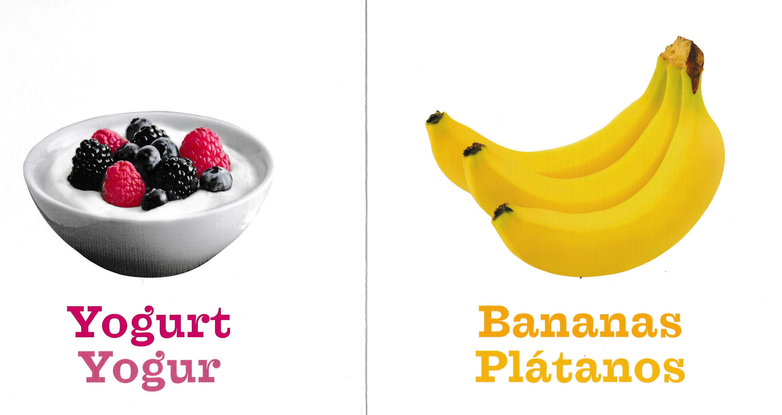
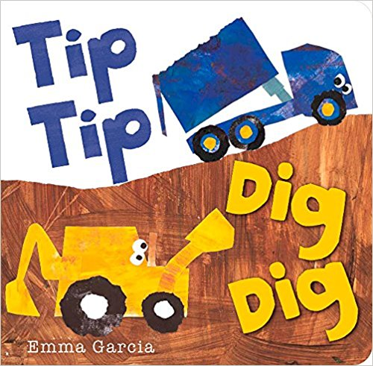
Birth-18 months
For birth to 18 months
Infants
Books with bright, clear pictures/photos
Stark contrast between pictures and background colors
Pictures that help you talk about the world around you
Books: Food: Los Alimentos (Say and Play Bilingual)
Tip Tip Dig Dig by Emma Garcia
Notes:
Here you see the book characteristics that babies and toddlers respond best to.
Any book you read with infants and toddlers provides an opportunity to talk about the world. Yes, it may just say “banana” but you can add information on how it feels, the skin is smooth and hard, and inside it is mushy; what can we make with bananas, how do they grow
Tip Tip Dig Dig by Emma Garcia
Food: Los Alimentos ((Say and Play Bilingual) Sterling Press

Slide 16
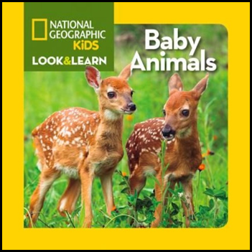
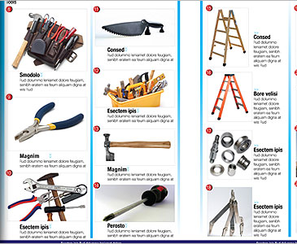
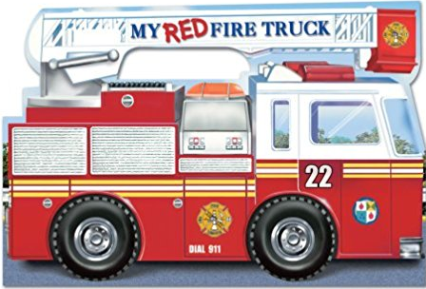
Birth-18 months
For birth to 18 months
Toddlers
Books with clear pictures
Simple factual books
Catalogs, magazines
Books: My Red Fire Truck by Chip Lovitt and Thomas LaPadula and National Geographic Kids Look and Learn Baby Animals by National Geographic Kids.
Notes:
We can use lots of print materials to share content information. Even a catalog offers opportunities, not just to talk about the names of the objects, which would support vocabulary, but also to talk about what they are used for, what they are made of, when you might have used them.

Slide 17

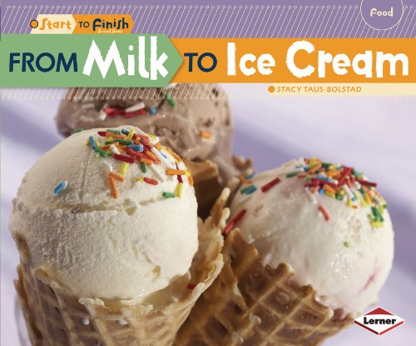
18-36 months
For 18 – 36 months
Use catalogs, magazines, factual books on topics of interest to the children
Relate the contents to the children’s experiences
Add information you know on the topic
Books Dump Trucks, Bullfrog Books;
From Milk to Ice Cream, Lerner Books
Notes:
We use factual books as great conversation starters. We can read some of the information offered in the book, adding any information we may have.
And relate the topic to the children’s own experiences.
No need to read the whole book. Even modeling with a page or two is fine.
For each storytime targeting ages 2 and up, we should include at least one factual book, even if you don’t read the whole book through.
It is important for parents and caregivers to understand the value of sharing factual books with their children. They often think of the non-fiction section as “the homework section.”
I have found a lot of books go out when I have a display of them at storytime.

Slide 18
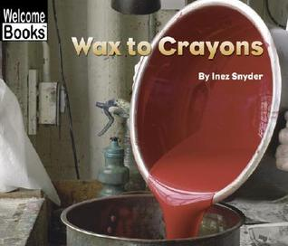
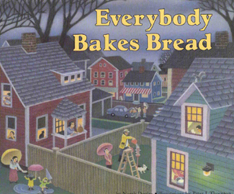
For 3 – 5 years
3-5 years
Factual books on topics of interest to the children
Books about other places and situations
Add information you know on the topic
Encourage children to share information on topic
Preschoolers are curious about
so many topics
Books: Wax to Crayons by Inez Snyder; Everybody Bakes Bread
Notes:
Preschoolers are curious about so many topics and it varies from child to child.
They are often avid collectors and like to collect facts as well.
We often see a sense of pride as they share information they know.
Dinosaurs—don’t worry Mr. Jim, he’s a vegetarian!
Introducing children to topics and information not in their immediate world helps them learn about our world which will later help them understand what they will read.

Slide 19





Acknowledgements
This project is funded by OCLC and by a grant from the Institute of Museum and Library Services, RE-95-17-0085-17
With appreciation for our Content Partners:
  The Campaign for Grade-Level Reading
  Project Outcome
  Saroj Ghoting
Notes:
First, I want to say that we are all here due to the generous support of OCLC and the Institute for Museum and Library Services.
And we appreciate the support of our content partners.

