Slide 1
Background Knowledge Part 2
Child’s Prior Knowledge About the World
Notes:
Welcome to Supercharged Storytimes
In this module, we look at the rest of background knowledge.

Slide 2
Book/Story Knowledge
Understanding the
structure of stories,
and enjoyment of books and reading
Notes:
Let’s look at the topic of Book and Story Knowledge

Slide 3
Book/Story Knowledge includes…
How stories work ⎯the structure and language of a story
Narrative skills ⎯retelling stories or events
Print motivation ⎯child’s interest in and enjoyment of books and reading
Notes:
It includes
How stories work—the structure of story and the language of story
Narrative skills—telling and retelling stories, recounting events
Print Motivation—child’s interest in and enjoyment of books and reading

Slide 4
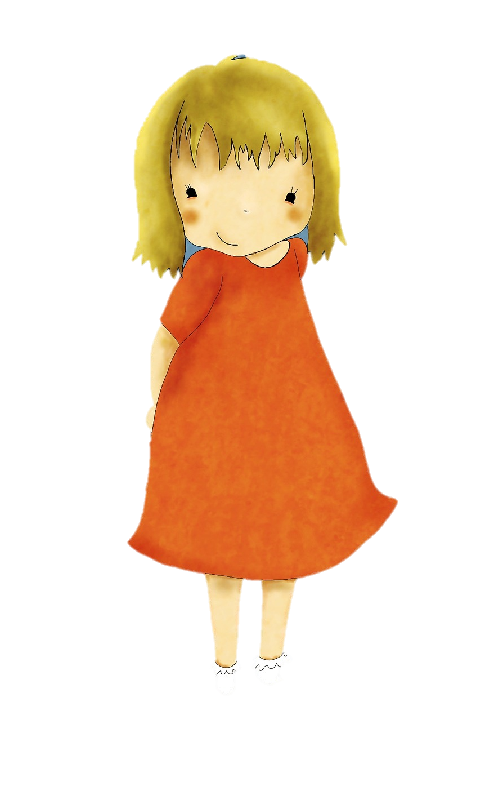
A. How stories work
⎯the structure and language of a story
Story language
Structure
“Once upon a time, there was a
girl named Goldilocks. …”
begin-ning
middle
end
“Porridge is just right” …”Chair is just right” …”Bed is just right”
Repeating motif
Image: “Goldilocks” by JenDigitalArt / on Pixabay
Notes:
Children learn about story structure and the language of story not only from hearing stories, but also from telling or retelling stories.
Stories have a beginning, a middle, and an end.
There are certain motifs that are common, like three of a type of character, or actions done three times.
Language of “once upon a time” “the end” or “snip snap snout, this tale’s told out”
Use of repeated phrases
Image: “Goldilocks” by JenDigitalArt / on Pixabay: https://pixabay.com/en/girl-little-girl-child-kid-cute-2852252/

Slide 5
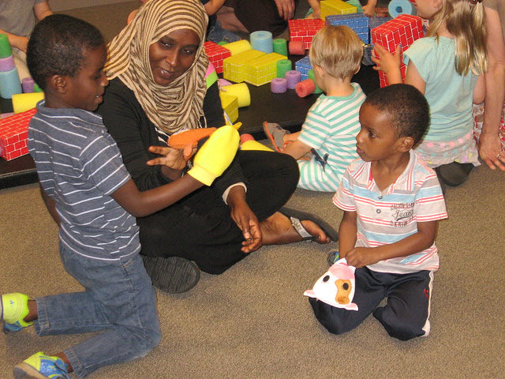
B. Narrative skills
⎯retelling stories or events
Build children’s ability to describe things and events, and to tell and re-tell stories
Photo by Allen County (IN) Public Library / CC BY-NC-ND 2.0
Notes:
Narrative skills, the ability to tell and retell stories and events, overlaps with the oral language component, speaking skills, the expressive aspect of language.
Developing a child‘s narrative skills, their ability to tell and retell stories, is one way to help them understand story structure and language.
In a broader sense, narrative skills supports all areas of background knowledge and leads to comprehension.
Children can express what they are thinking, simply at first, and then more complicated ideas and longer sentences as they get older.
Photo by Allen County (IN) Public Library / CC BY-NC-ND 2.0

Slide 6

C. Print Motivation ⎯child’s interest in and enjoyment of books and reading
Why is print motivation important?
Children who enjoy books and reading will be curious about how to read and will read more
Children become good readers
by practicing.
Photo: Boy sitting on books reading by PublicDomainPictures on Pixabay
Notes:
Print motivation is a child’s interest in and enjoyment of books and reading
Research notes: Children who have had positive experiences around books and reading are more likely to stick with learning to read longer than children without these positive experiences. 60% of our children find learning to read difficult when they are formally taught to read in school. So, if they have positive experiences around books and reading, it may get them over that hump.
Enjoyment of books may seem natural to us, but it is learned behavior. Children learn whether reading is an enjoyable activity or not from the experiences they have around books and reading,
Read 20 minutes a day—give example
It is more important for the interaction around a book to be positive than it is to be long. Will grow long when enjoyable.
In storytime, when so chaotic, may not finish a book—say it!
We don’t turn it into a power struggle.
Photo: Boy sitting on books reading by PublicDomainPictures on Pixabay: https://pixabay.com/en/child-book-boy-studying-isolated-315045/

Slide 7
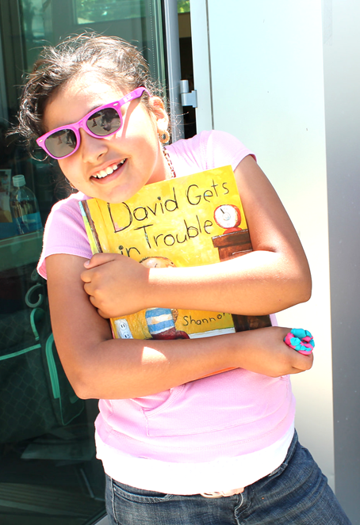
Brainstorm!
Supporting Print Motivation
Photo: Lunch at the Library by San José Public Library on Flickr CC BY-SA 2.0
Notes:
Here’s an opportunity for us to brainstorm! How do you support print motivation in your storytimes both through modeling activities and providing tips for adults?
: ***INTERACTIVITY –transcribe key ideas to screen;
acknowledge their ideas and affirm that they are supporting print motivation, even if they didn’t have the name for it
Could add if not noted:
Set up display of books in storytime, including factual books, and if you can gather multiple copies of books you have shared in storytimes.
Tip to parents—have children choose book to read together, children love repetition and need repetition to learn; you can take turns choosing books
Tip to parents—substitute your child’s name for character in the book
Photo: Lunch at the Library by San José Public Library on Flickr: https://www.flickr.com/photos/sanjoselibrary/27439342320/ CC BY-SA 2.0

Slide 8
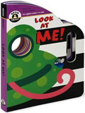
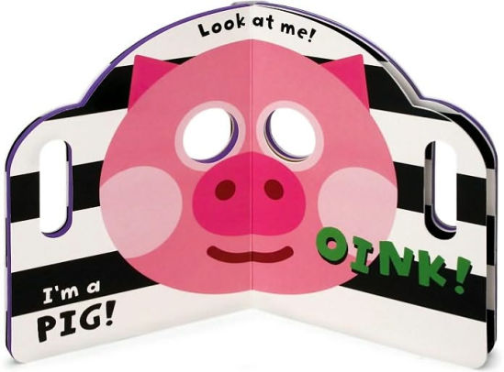
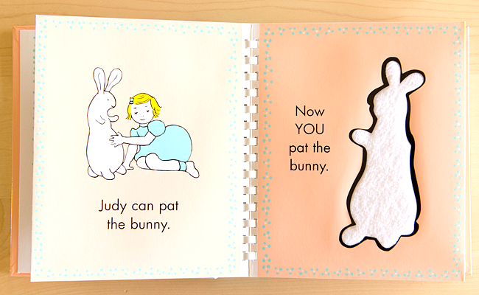
Birth-18 months
For birth to 18 months
Infants
Use board books or small, chunky books for little hands
And books to play games like peek-a-boo
Infants like
books that use
their senses
Books: Pat the Bunny by Dorothy Kunhardt; Look at Me! By Elliot Kreloff
Notes:
For print motivation, we simply need books we think the children will enjoy and interact with.
Small chunky books for little hands
Bright, clear pictures
Stark contrast between pictures and background colors
Flap books and others that you can play games with like peek-a-boo
Books with texture, using their senses
Using parentese until about 9 months old as we read books will keep their attention longer.
We all know babies will chew on books—parent reaction
Bat at books as they imitate us trying to turn pages
Look at Me! by Elliot Kreloff, Sterling Children's Books 2008
Pat the Bunny by Dorothy Kunhardt, Golden Books 2001

Slide 9
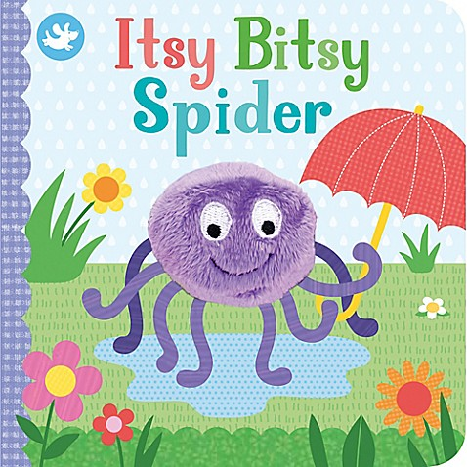

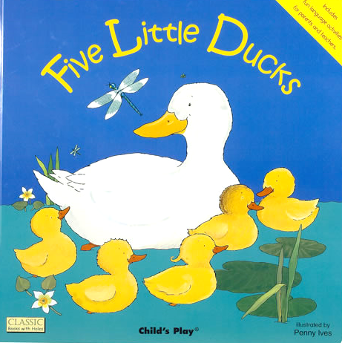
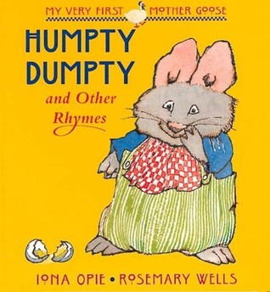
Birth-18 months
For birth to 18 months
Infants
Use books
Based on songs
With nursery rhymes
With rhyme and rhythm
Books: Itsy Bitsy Spider; Five Little Ducks, illus by Penny Ives;
Humpty Dumpty and Other Rhymes by Iona Opie & Rosemary Wells
Notes:
Infants and toddlers respond to rhythmic language and singing
While we don’t need books to sing, there are many board books based on songs.
Books: Itsy Bitsy Spider; Five Little Ducks, illus by Penny Ives; Humpty Dumpty and Other Rhymes by Iona Opie & Rosemary Wells

Slide 10
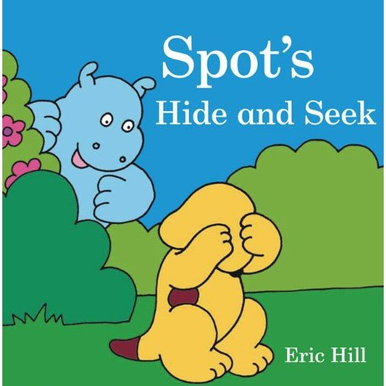
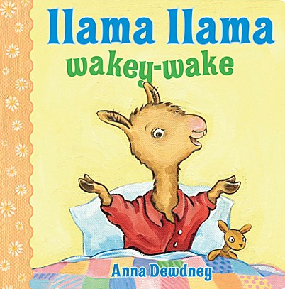

Birth-18 months
For birth to 18 months
Toddlers
Use books with:
clear pictures of familiar characters, animals, food
familiar experiences, faces, family
Simple stories and repeated phrases
Books: Spot’s Hide and Seek by Eric Hill; Llama Llama Wakey-Wake by Anna Dewdney; Look at You! Courtesy of Star Bright Books
Notes:
Books with clear pictures of familiar characters, animals, food
Books with familiar experiences, faces, family
Books with simple stories
Spot’s Hide and Seek by Eric Hill, Putnam Juvenile, 2010
Look at You!
Llama Llama Wakey-Wake by Anna Dewdney

Slide 11
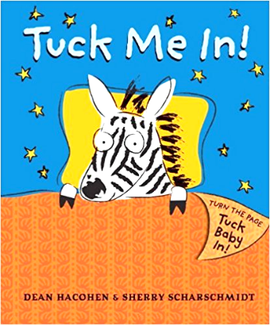
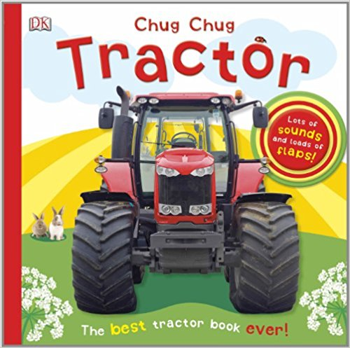
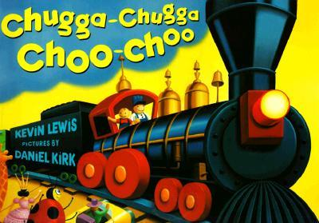
18-36 months
For 18 – 36 months
Choose books with repeated phrases or actions
Encourage children to participate ⎯say the repeated phrase, say sounds of animals
Ask children “what” questions ⎯”what is this?”
Books: Tuck Me In! by Dean Hacohen & Sherry Scharschmidt;
Chugga-Chugga Choo-Choo by Kevin Lewis; Chug Chug Tractor by DK
Notes:
We support all of book and story knowledge.
Repetition—enjoyment and the structure of story
Children love repetition. They learn through repetition.
Choose books with repeated phrases or actions.
Repeat the book over several storytimes. Parents are reading books over and over again. For regular storytimers, they are seeing you model different ways to share the same book.
Participation, that interactivity brings enjoyment:
Encourage child to point to picture and talk about picture. After pausing, you can
answer yourself if the child cannot.
Encourage child to say the sounds of animals.
Sing along with a songbook.
Chugga-Chugga Choo-Choo by Kevin Lewis, Hyperion Books for Children, 1999
Tuck Me In! by Dean Hacohen Candlewick 2010
Chug Chug Tractor by DK Publishing 2013

Slide 12
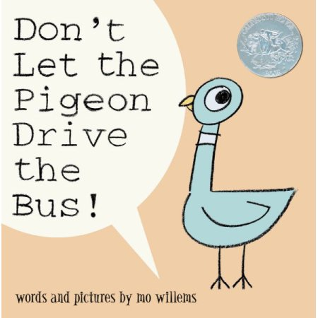
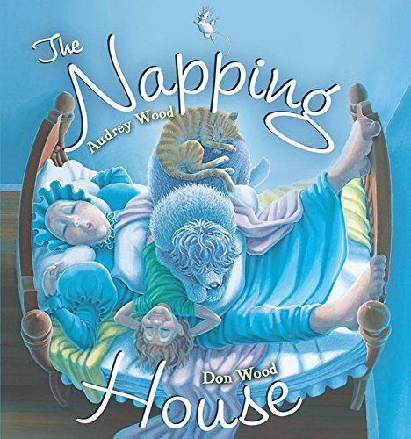
For 3 – 5 years
3-5 years
Repetition ⎯say a repeated or cumulative sequence
Questions ⎯ask open-ended
Demonstrate enjoyment
  Use different voices for different characters
  Tell children what you like about a book
  Ask children what they like about a favorite
  book
Books with humor
Use factual books on topics of interest
Read favorite books over and over
Books: Don’t Let the Pigeon Drive the Bus! By mo willems;
The Napping House by Audrey Wood and Don Wood
Notes:
For the preschoolers, we can take some of the elements of books and book sharing from the younger groups, but we apply it in a more challenging way.
For example, with repetition, instead of just a word or phrase, they can repeat a sentence, or add to a cumulative tale, or help with retelling a whole story.
Ask open-ended questions that allow the children to express their own interests and experiences.
Ask the child what s/he likes about a favorite book.
Let them know when you are reading a favorite book and what you like about it.
Factual books on topics of interest to your child insures more interest
Books with humor certainly contribute to enjoyment
Books that expose them to new experiences and information build on world knowledge

Slide 13

Connecting Background Knowledge to the 5 Practices
Talk
Sing
Read
Write
Play
We’ve got
this one
covered
Notes:
Now that we have looked at supporting background knowledge through books, let’s look at how we can support all aspects, conceptual thinking, content knowledge, and book and story knowledge through the other practices.

Slide 14
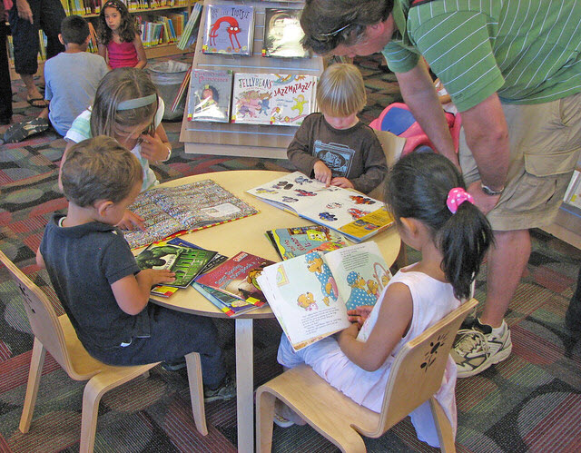
TALK
…elaborate and explore topics
Using factual books, add information you know
on the topic
Talking about information you know.
Encouraging children to tell
you what they know and ask questions about the topic
Exploring ways to find information
Tell and retell stories
Talk about what is happening
Photo by San José Public Library / CC BY SA
Notes:
Talk about true topics of interest to yourself and to children, anywhere!
So in storytime, perhaps during intro to your storytime; for parents and caregivers—throughout the day
Encourage children to tell stories, recount events—this could take place during a storytime activity time at the end of the storytime, or for parents—anytime!
Talk about what is happening—in a storytime you might give them the sequence of what is happening in storytime—first we will have our opening song, then . . .
Model thinking and reasoning: It is hard to hold all these shakers in my arms. They kept falling so I found this woven basket.
You may offer a tip to parents about talking about the world around them—how do all these items get to the grocery store? When I turn on the switch, the light comes on
Photo: https://flic.kr/p/5jXjNp

Slide 15
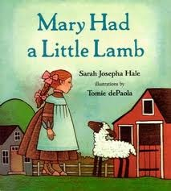
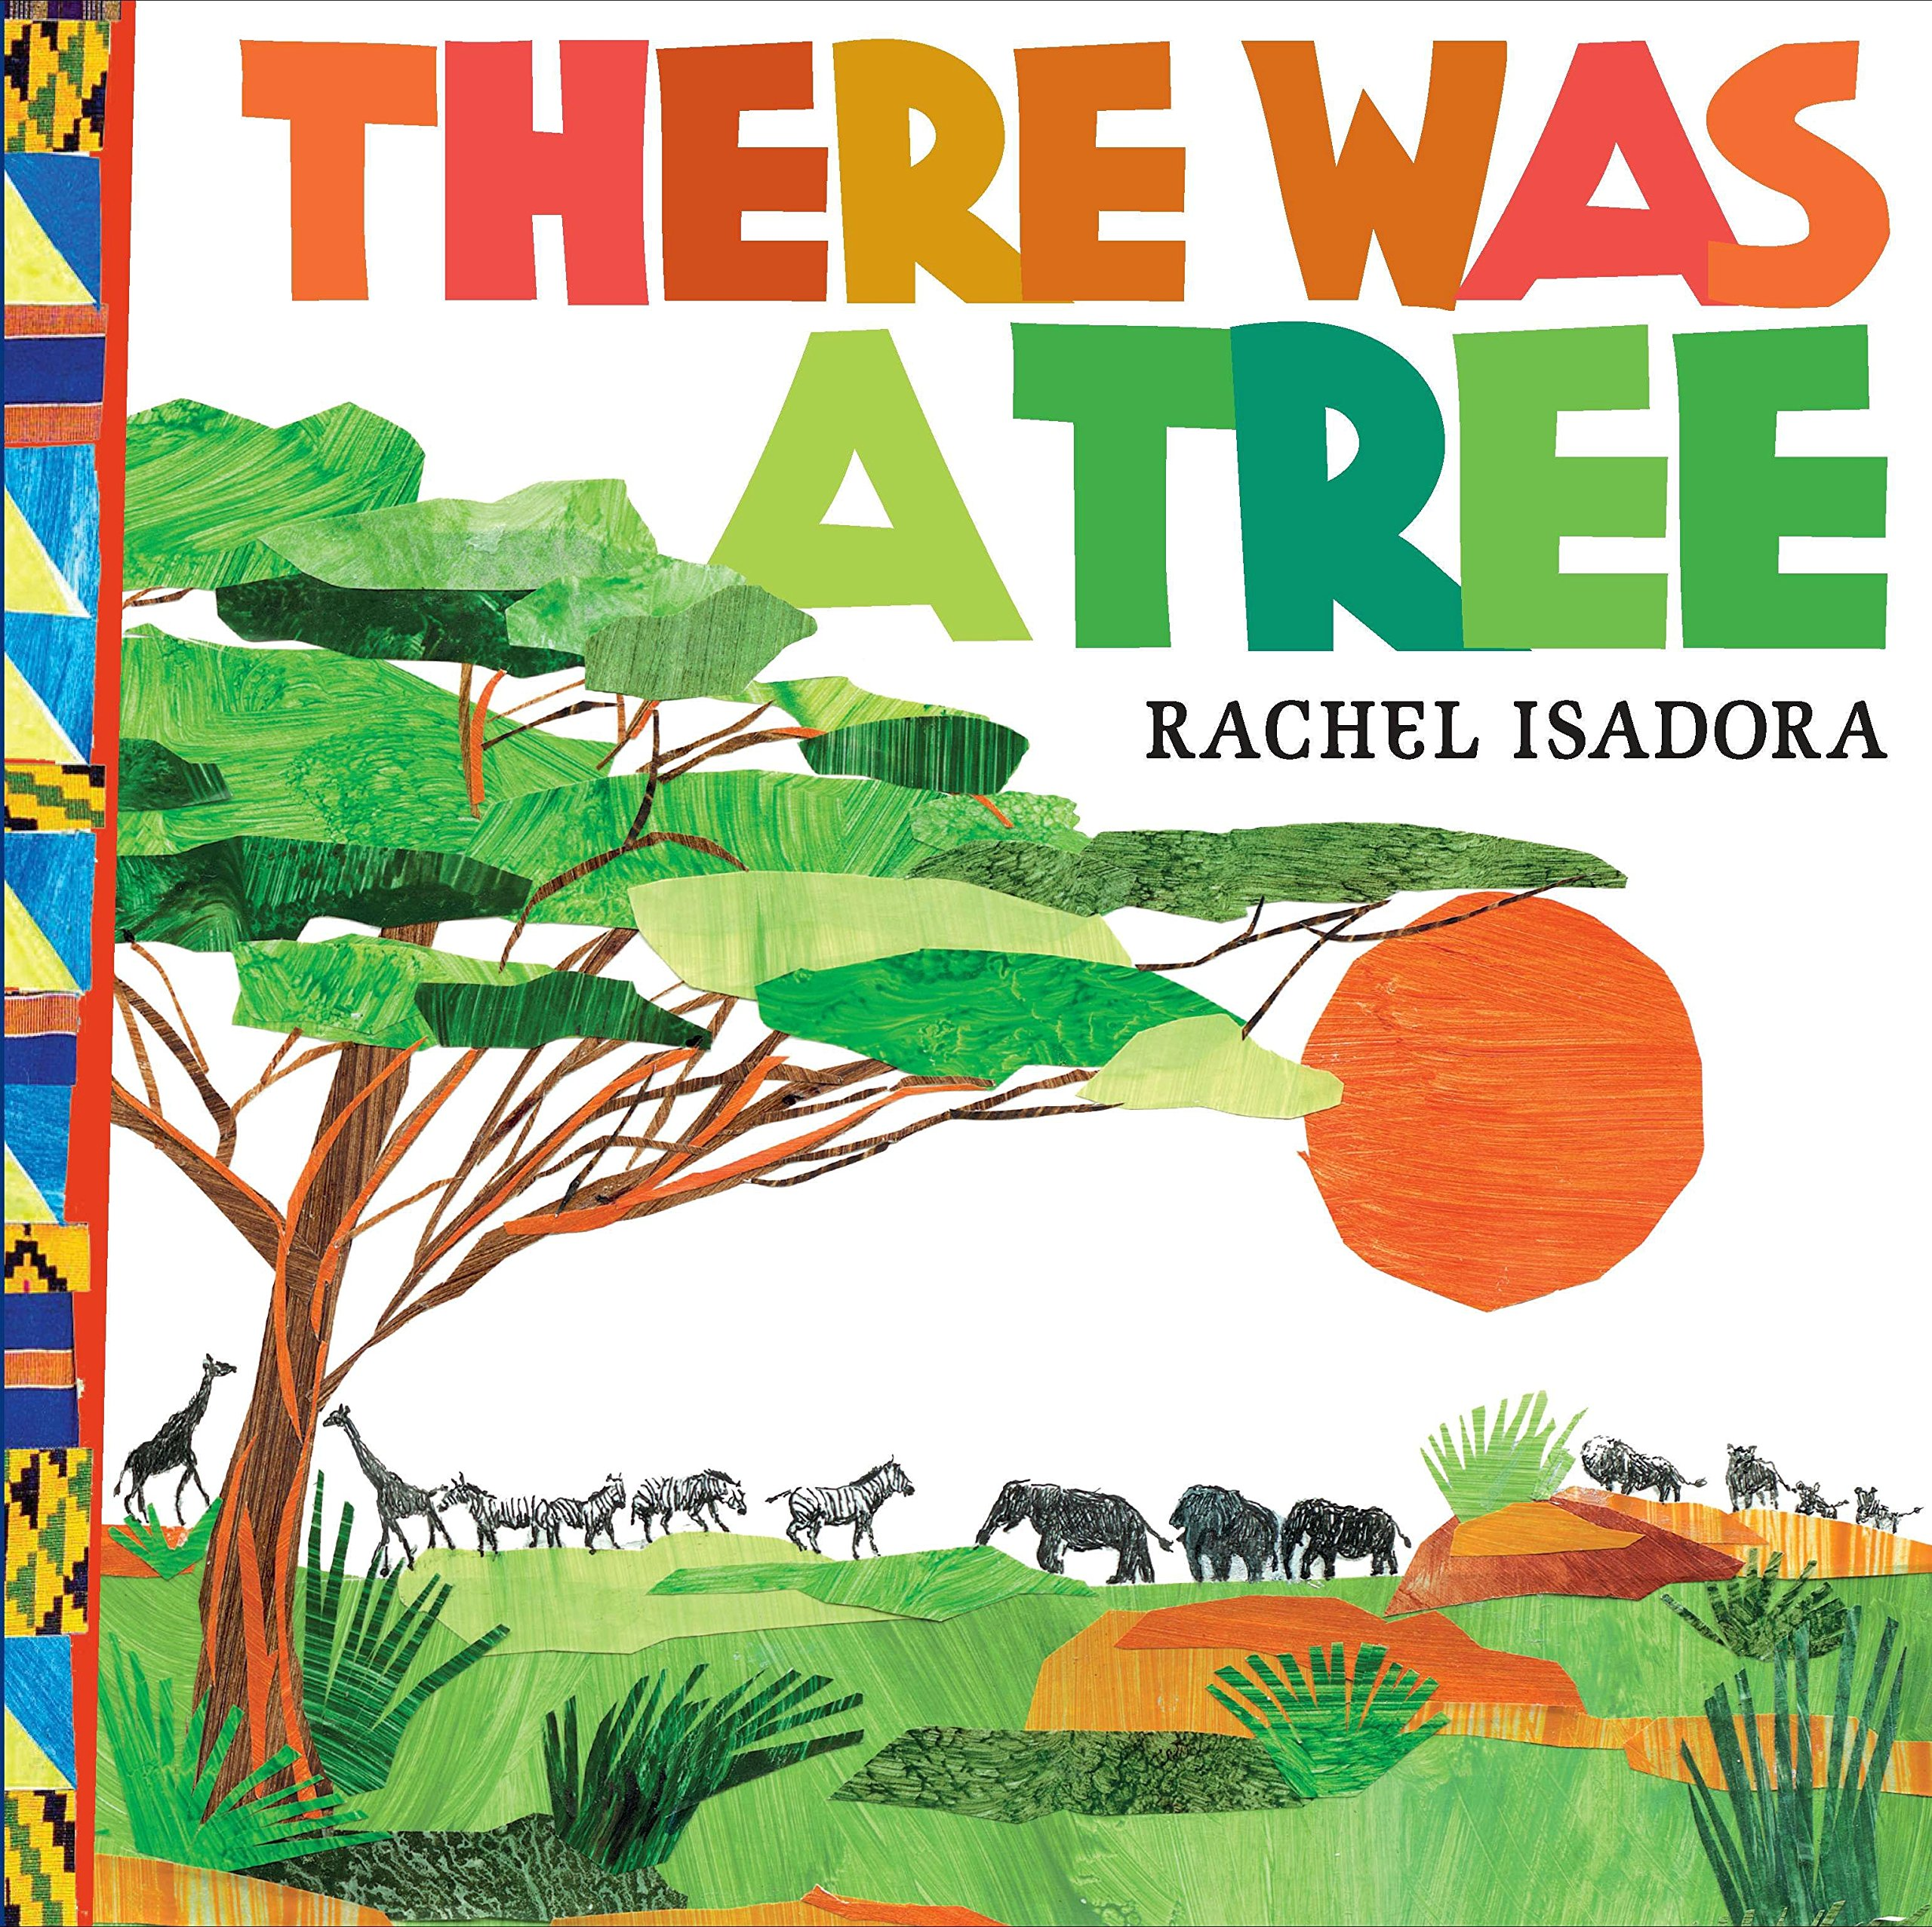
SING
Nursery rhymes and songs of a culture
Songs with sequence: Green Grass Grows All Around
Songs with story: Mary Had a Little Lamb
Books: Mary Had a Little Lamb by Sarah Hale, Illustrated by Tomie de Paola;
There Was a Tree by Rachel Isadora
Notes:
Rhymes and songs of different cultures, this is part of cultural knowledge
Mother Goose rhymes referred to in literature
Cumulative songs--sequencing
Songs for print motivation: The More we Read Together
There Was a Tree by Rachel Isadora (this is based on Green Grass Grows All Around)
Mary Had a Little Lamb by Sarah Hale, Illustrated by Tomie de Paola

Slide 16
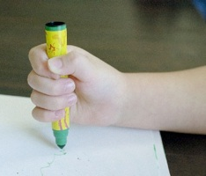
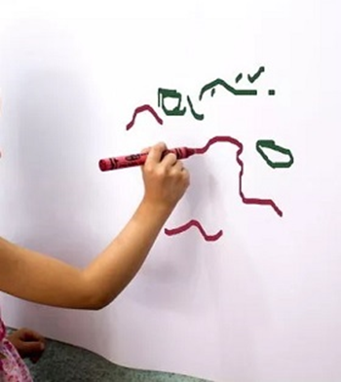
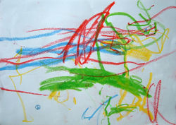
WRITE
Writing about their own experiences
Book: More than Letters by Sally Moomaw and Brenda Hieronymous
Notes:
Write their own story
Make a book
Draw about a topic they know
Draw about an experience they had and tell about it

Slide 17
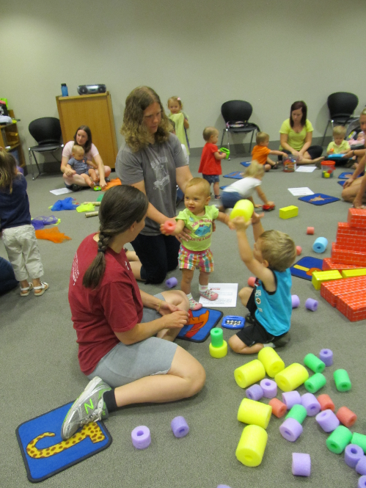
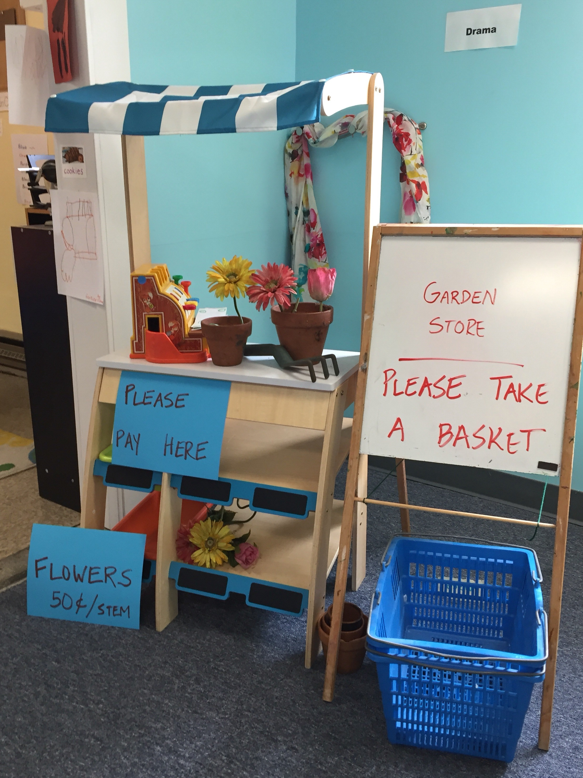
PLAY
Symbolic play
Garden photo – courtesy of Brooke Doyle; Block photo: Toddler-Palooza in Children’s Services at Main by Allen Co (IN) Public Library on Flickr / CC BY-NC-ND 2.0
Notes:
Symbolic play—supports symbolic thinking needed for language
Act out stories, role play
Make up own stories
Imaginary play
Problem solving around and through play
Talk about real things—going to doctor, add factual information

Slide 18
ALL the early literacy components work together
Oral Language ⎯ Foundation for all language
Phonological Awareness ⎯ Hearing smaller sounds in words
Print Awareness/Print Concepts ⎯ Knowing that print has meaning
Letter Knowledge ⎯ Exploring letters
Vocabulary ⎯ Knowing words
Background Knowledge ⎯ Prior knowledge about the world Conceptual Thinking Concept Knowledge Book and Story Knowledge
Notes:
So now you have an overview of all the early literacy components.
Children need all the early literacy components to become successful readers.
And they all develop from birth.
They do not just evolve, they are learned skills and behaviors, that need adult modeling and support.
You will find that one activity can go for more than one early literacy component. Singing a song can go for phonological awareness or for vocabulary.
Talking about shapes could go for conceptual thinking under background knowledge, or for vocabulary—knowing the words for the shapes, or for letter knowledge—children identify letters by their shapes.
It is important to understand the different components, but not to get bogged down in them.

Slide 19
Constrained
Skills
Unconstrained
Skills
Phonological Awareness
Print Awareness
Letter Knowledge
Vocabulary
Background Knowledge
Decoding
Comprehension
Notes:
Dr. Scott Paris noted differences in the components.
He designated phonological awareness, print concepts, and letter knowledge as “constrained skills”
Vocabulary and background knowledge are unconstrained.
Constrained skills are finite, that is, there are 26 letters in the alphabet, there are 44 phonemes or sounds in the English language, there are a finite number of print concepts. These all most directly support decoding, sounding out words, and predict early reading success, to 2nd grade.
Unconstrained skills are infinite—we are always learning new words, developing vocabulary, and also learning new information throughout our lives. Unconstrained skills most directly support comprehension and predict reading success at grades 4 and up, and high school graduation.
Children go from learning to read to reading to learn.
However, now schools are trying to not make such a distinction in these two areas.
For example, they are introducing more factual books in kindergarten, so children will have heard the word metamorphosis before they read it.

Slide 20



Scaffolding with Children
Climbing the ladder step by step
Children: build early literacy
skills/abilities appropriate to
age level
Notes:
Scaffolding is an educational term for adjusting the level of learning and assistance provided to fit the child’s abilities. More support is offered when a task is new; less is provided as the child’s competence increases, thereby fostering the child’s independence and mastery. [Berk, Scaffolding Children’s Learning, p.171]
We adjust our level of assistance to fit the child’s needs. As they go from crawling to walking, we are holding both their hands, then one hand, then standing a little bit away from them, then moving farther away. We are just beyond their competence to help them grow.
In a group situation, we cannot scaffold what we do to fit each individual child. However, we may notice when something is too hard or not challenging enough for the group as a whole.
PUSH IN CHAT: Ideas for scaffolding in storytimes
https://www.youtube.com/watch?v=U_neUKZQMjM [add to resources, please]
Because the Early Literacy Planning Tool is divided into age level sections, you see a progression for each component, offering you options for strategies and activities that are more or less complex. The age ranges are broad and individual children develop at different rates. However, you can use the Tool as a guide to make activities easier or harder.
Images:
Blocks: http://www.freeimageslive.co.uk/free_stock_image/building-concept-jpg
Baby (vector) by OpenClipart-Vectors on Pixabay: https://pixabay.com/en/baby-crawling-child-infant-shadow-147416/
Toddler (vector) by GDJ / 2688 images on Pixabay: https://pixabay.com/en/child-baby-toddler-infant-kid-1769717/

Slide 21

Planning Storytimes
Choosing Books, Songs, etc.
We like; we enjoy
We think the children will enjoy—remember factual books
Appropriate for the targeted age-level
Work well in a group
Photo: Puppet play by Miki Yoshihito on Flickr: CC BY 2.0
Notes:
So now that you have boosted your interactivity, your intentionality, incorporated tips, and are giving consideration to scaffolding, how are you planning your storytimes?
I want to emphasize how we are choosing our storytime books and other items:
Read slide
Did you hear anything about theme? Yes, you can still have a theme! But it is not your first consideration. Themes don’t have to be nouns. Catch me if you can is a theme; Librarian’s favorites is a theme.
Do you see here anything about early literacy components? No, you are not planning your storytime around an early literacy component. With a tip you need only find one item and support one component which you will highlight.
Remember how you were being intentional even around one item? Storytimes are versatile. It is how you USE the book, song, or other item that makes it support an early literacy component.
Your intentionality will help you make connections between your storytime items, what you are doing and how you are doing it, and ways to support early literacy.
Storytimes are full of opportunities to support early literacy. This frees us to choose the books and language activities we love and that children will enjoy as well.

Slide 22





Acknowledgements
This project is funded by OCLC and by a grant from the Institute of Museum and Library Services, RE-95-17-0085-17
With appreciation for our Content Partners:
  The Campaign for Grade-Level Reading
  Project Outcome
  Saroj Ghoting
Notes:
Thank you to the generous support of OCLC and the Institute for Museum and Library Services as well as our content partners.

