Slide 1
Outcome Measurement Made Easy: Supercharged Storytime & Project Outcome
How to use Project Outcome for Supercharged Storytimes
Notes:
Welcome to Outcome Measurement Made Easy: Supercharged Storytime & Project Outcome - How to use Project Outcome for Supercharged Storytimes

Slide 2
Why Project Outcome in Supercharged Storytimes?
Project Outcome Toolkit makes patron-level data gathering easier
Data points are standardized so responses can be aggregated
Data informs us of caregiver changes after attending a Supercharged Storytime Session
Increased understanding of impact of this program on literacy needs
Notes:
The ease of use and pre-set questions in the Project Outcome toolkit create a lower barrier of entry for library staff gathering patron data about the outcomes of the Supercharged Storytimes, helping libraries understand relatively quickly what the caregivers are learning after attending a session. And, because the toolkit allows for consistent data collection across all libraries, we can see the impact at both the state and national levels, giving us a broader picture about how these sessions are meeting literacy needs.

Slide 3
Create a Supercharged Storytime (SCST) Survey

Slide 4
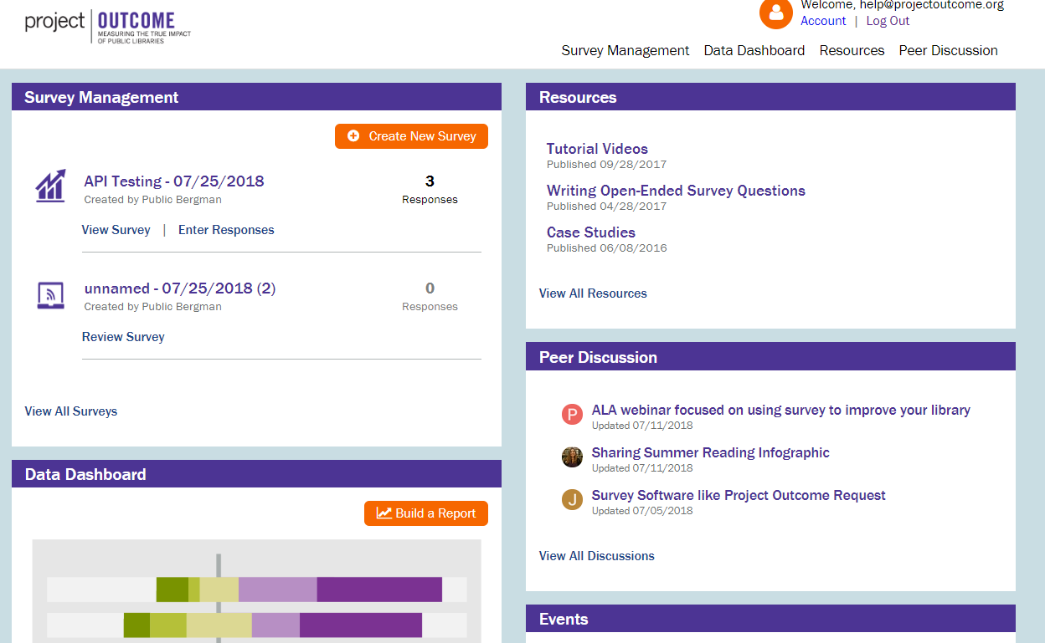
SCST Survey: Getting to the Survey Page
Notes:
Click on the survey management menu link when you sign into your landing page of www.projectoutcome.org.

Slide 5
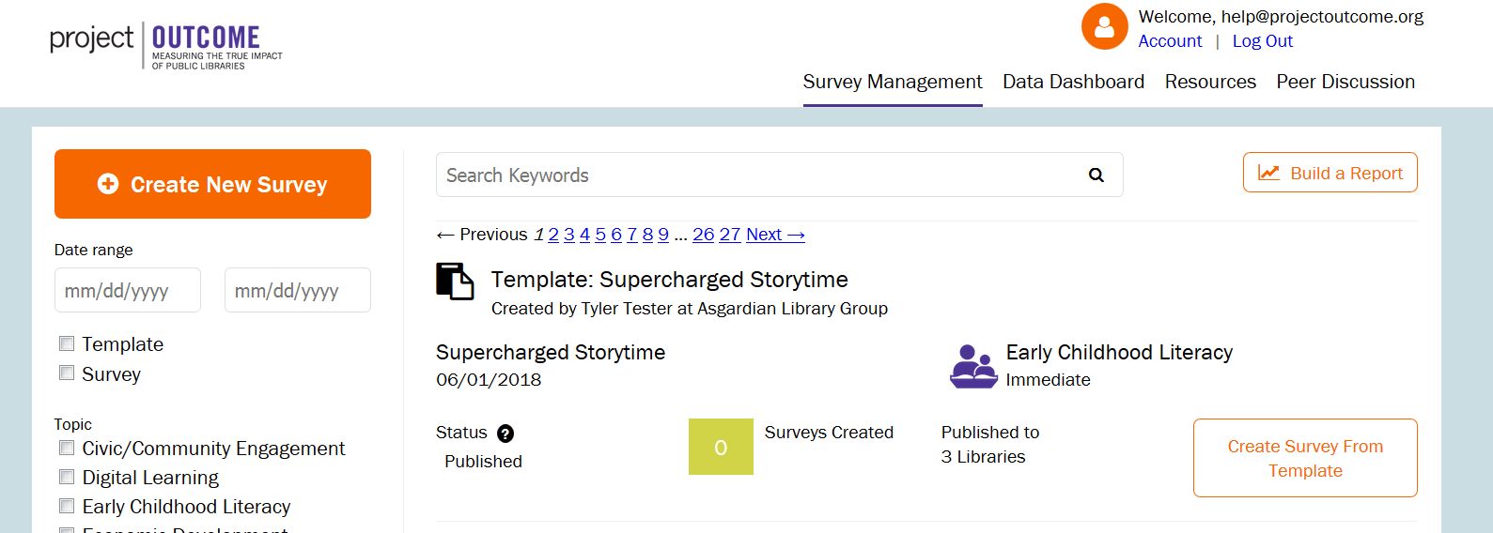
SCST Survey: Creating a Survey From a Template
Click on “Create Survey From Template”
Notes:
When you get to your survey management screen, you’ll see a template pre-populated in your survey management toolkit. It will be titled, “Supercharged Storytime.” You’ll use this template which already has some pre-populated text in it that you won’t need to complete, saving time for you.
Start by selecting the “CREATE SURVEY FROM TEMPLATE” button

Slide 6
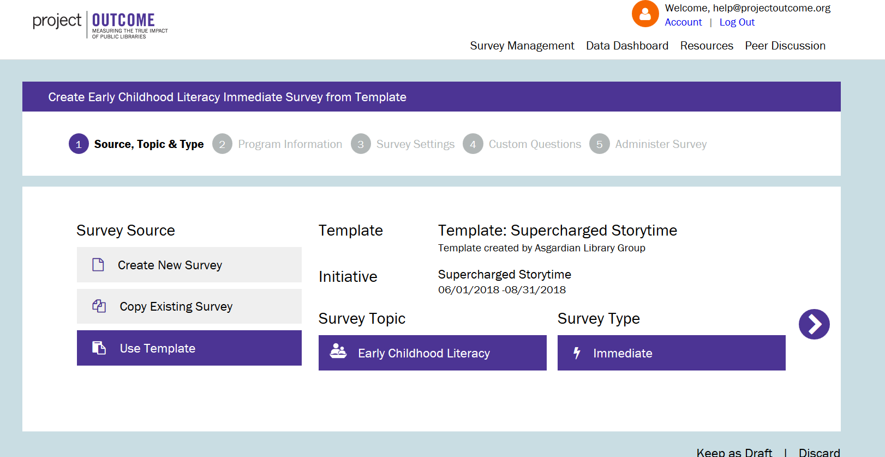
SCST Survey: Pre-set Template Selections
Notes:
On the next page you will see the survey source, topic, and type have been pre-selected for you. This is part of the template the State created on your behalf. You do not need to do anything on this page, so simply continue to click forward to the next step using the purple, right arrow on the screen.

Slide 7
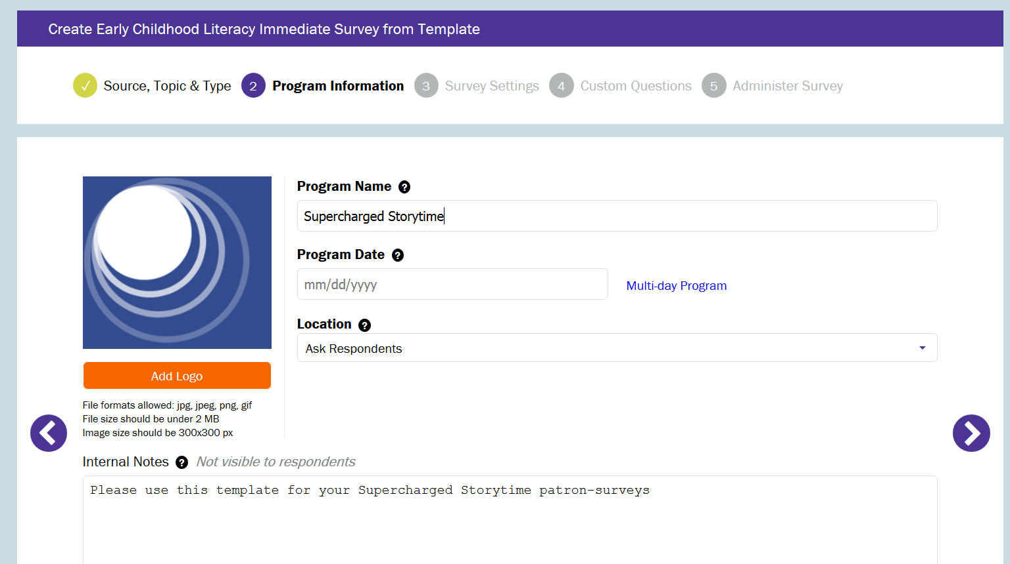
SCST Survey: Program Information
Be sure to name it “Supercharged Storytimes”
Notes:
Step 2 allows you to add your own customization to the survey template, allowing for you to track activity at the library level.
You will first name your program, “Supercharged Storytime.”
Next you can select a single program data if you are measuring only once, or for a range of dates if you plan to measure several times.
You can set the location for a specific branch or allow respondents to identify the library location.
You can choose to add your own logo or not. If you do, it will display on the survey. If not, the logo area will be blank.
Lastly, you may see internal notes completed by the State with directions to you. You can also add your own notes to staff here if you like.
Proceed to the next step using the purple, right arrow.

Slide 8
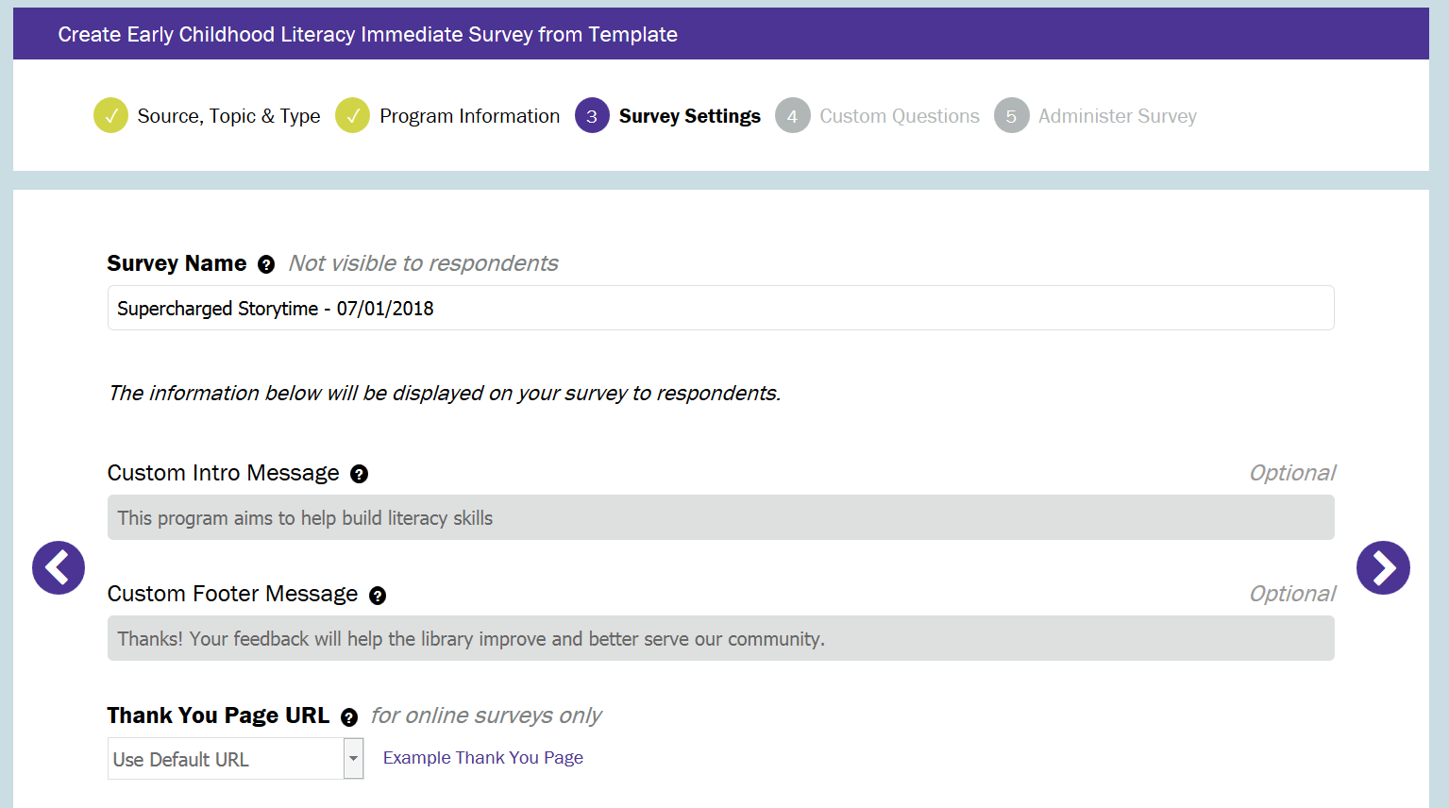
SCST Survey: Survey Settings
Notes:
A survey name will be automatically populated in this screen. You can change it or leave it as is, as long as the survey name is unique every time.
The intro and footer messages and Thank You Page will have been pre-populated by your state or regional library entity, so you will not be able to add or edit information.
You can proceed to the next step by clicking on the right arrow.

Slide 9
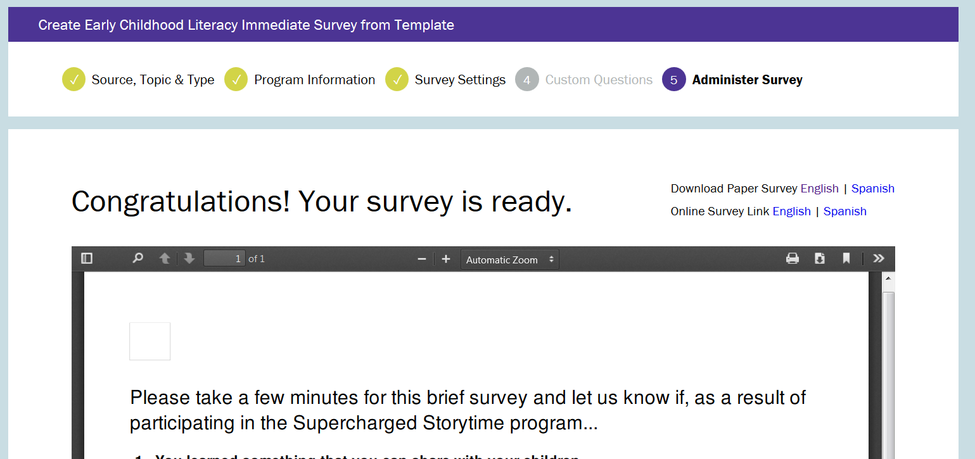
Supercharged Storytime: LIBRARIES
Notes:
And just like that, your survey is ready to go! You will be able to print it off or get an online link with text in either English, Spanish or in French. You can also print a survey or administer it online.

Slide 10
Ready to Gather Data!
Decide when to administer the Project Outcome survey
Directly after conclusion of storytime
Determine frequency based on what you want to learn
Measure consistently
After a period of time has passed
Collect contact information separately
Plan for repeated follow-up to collect response
Reduced response rate
Notes:
The easiest path to getting started measuring is to just measure once. If you have a program series, you can hand out surveys at its conclusion. If you plan to survey once during a regular or recurring program, try to measure when you tend to have a larger group of attendees so that you can get a larger data set.
If you want to capture changes in patrons learning from a beginning and end point of a program series, you will want to measure twice: Once after the first program has concluded and again after the last program.
If you have regular programs and want to capture feedback from different groups of patrons, you might want to run surveys over the period of a month on different days of the week when you are likely to have different crowds of attendees.

Slide 11
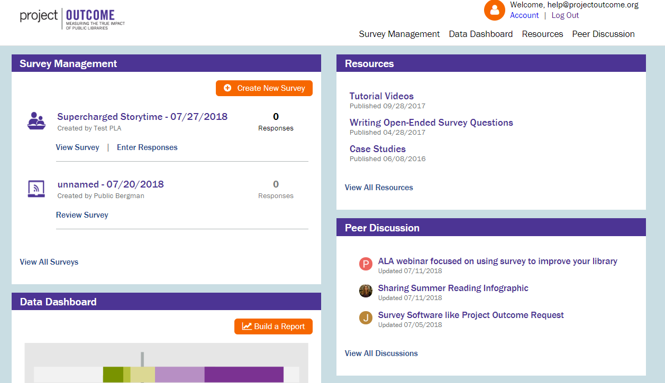
SCST Survey: Manage Your Surveys
Notes:
After you have set up your survey, it will now show up on your toolkit home page. You can it to enter responses and download your raw data

Slide 12
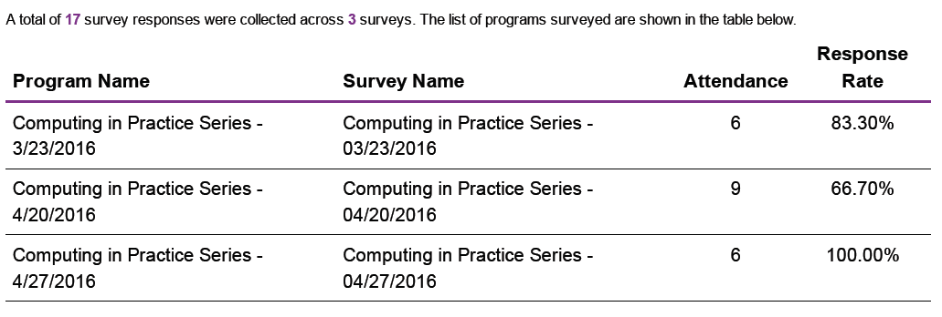
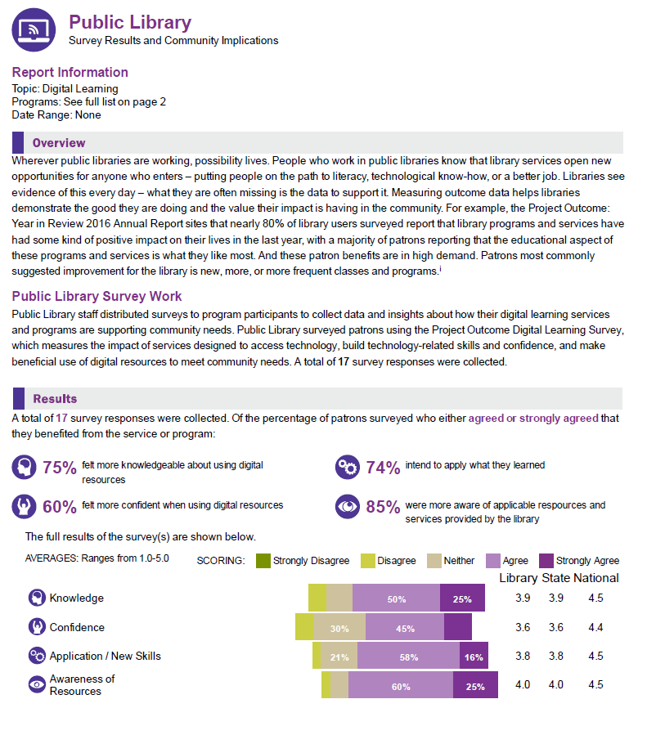
SCST Survey: View Results
Notes:
The data you enter automatically aggregates on the data dashboards where you can build customized reports for your Supercharged Storytimes.

Slide 13
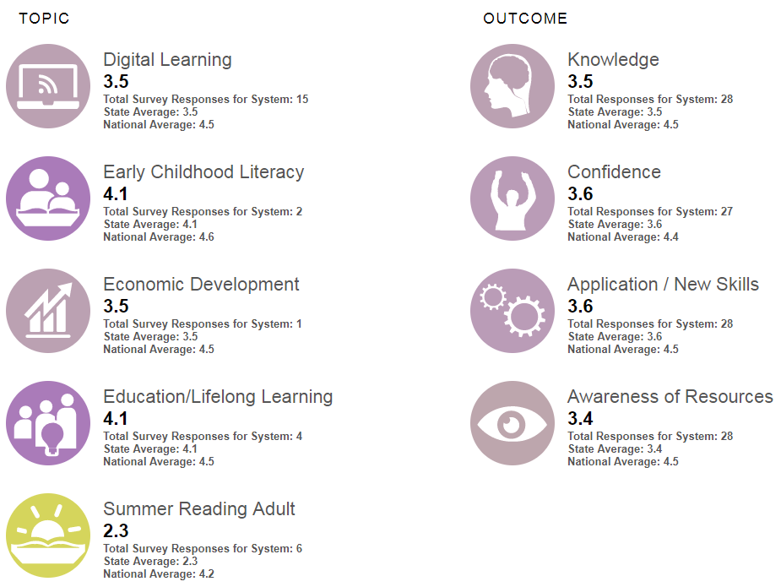
SCST Survey: Data You Can Use
Notes:
And you can see your aggregated results in a variety of data view. We calculate data automatically and you can see your scores relative to state and national scores.

Slide 14
Tips for Success
Notes:
And before I wrap up, I’ll share a few key tips we’ve heard from libraries out in the field that are running Project Outcome surveys.

Slide 15
Planning to Measure Outcomes
Prepare ahead of time:
Use paper survey
Print survey ahead of time
Have a follow-up plan if not surveying immediately after
Notes:
You’re already doing a lot to prepare for delivering as successful Supercharged Storytime, but doing a little more pre-planning will help ensure you are getting good responses from the caregivers.
Using paper surveys lowers the barrier for caregivers that may have very little time or attention span to fill out a survey. They can see it’s short and can fill it out in less than five minutes. If the library is using an ipad at the conclusion of the program, caregivers may not be willing to wait to complete the survey.
Printing the survey ahead of time ensures that you have it when you need it! We’ve heard from plenty of libraries that if they wait to the last minute to hand out the survey, they won’t have time or forget and then aren’t able to capture feedback.
And if you don’t plan to hand out a survey while the caregivers are in the library, you’ll need to create a form to collect their contact information so that you can follow-up with them. Following-up can be quite a bit more time consuming on library staff time and will reduce your response rate. If you decide to go this route, make sure you have enough staff time and capacity to apply this survey administration method effectively.

Slide 16
During Survey Administration
When you hand them out
Explain the WHY
Allow time for responses
Notes:
The WHY might seem obvious to the library, but explaining it to caregivers why you want them to complete surveys can help drive responses and get better feedback. Examples of the why can be, “The library wants your feedback so that we can continue to improve the programs we offer you,” or “The library relies on your feedback so that we can communicate the value of this activity to our partners, board, community, etc.” These are just examples of how to explain the why, so customize the language for your needs. But, what we have heard, is that when libraries explain the why, patrons see themselves as partners in improving library programming.
Also, end your program 5 minutes early to allow time for completion. This will help keep the response rate up. I have heard that library staff have blown bubbles during storytime to keep kids preoccupied while busy caregivers complete the survey.

Slide 17
Review Results
Read through paper responses
Recruit a volunteer to help with data entry
Notes:
You don’t want to collect surveys and not use the data, so even if you don’t have time to enter data immediately, you’ll most likely see some feedback about improvements you can be making right away, like the Douglas County Libraries example I shared in the first slideshow: maybe you just need to fix a pitch to make the singing more accessible. Sometimes small changes can make a big impact.
When it’s time to enter the data, you may want to recruit a volunteer to help enter it if you are concerned about the amount of time YOU have to complete this task.
Thank you!

Slide 18
Know How You Will Take Action
Target one key activity
Programming changes
Communication/Advocacy
Funding
Strategic planning
Partnerships
Take Action!
Notes:
Picture how you’d like to use the data throughout the process! While the data will be aggregated for larger learning needs, there’s a lot you will be able to do with what you’ve collected. Tell your board about your work and the results. Or use it to determine if you are meeting your literacy goals in your strategic plan. Regardless of your path forward, plan to take action using what you learn!

Slide 19
Next Steps

Slide 20
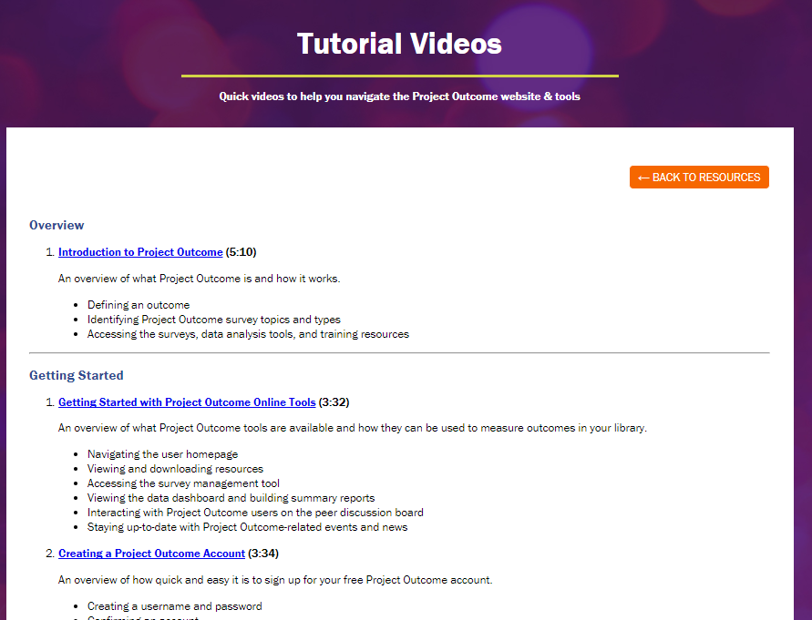
What’s Next: Create an Account
1) Watch Creating a Project Outcome Account
2) Create an account on ProjectOutcome.org. Login and begin to explore the resources in the toolkit.
3) Once you have set up your account, watch Getting Started with Project Outcome Online Tools
Notes:
Your next steps are to:
Watch the Creating a Project Outcome Account video in the online course,
Create an account a www.projectoutcome.org
And, watch “Getting Started with Project Outcome Online Tools.”

Slide 21
What’s Next: Ready, Set, Measure!
Inform staff of measurement plan
Comply with your privacy policy
Schedule surveys and enter data in toolkit
TAKE ACTION WITH WHAT YOU LEARN!
Notes:
The next steps for you are to inform staff of your measurement plan, make sure you are complying with your privacy policy, schedule your survey collection, collect!, enter the data, and take action with what you learn.

Slide 22
This project is funded by OCLC and by a grant from the Institute of Museum and Library Services, RE-95-17-0085-17
Notes:
Acknowledgement slide

