Slide 1
Outcome Measurement Made Easy: Supercharged Storytime & Project Outcome
Why measure outcomes and what you can do with outcome data
Notes:
Welcome to today’s webinar, Outcome Measurement Made Easy: Supercharged Storytime & Project Outcome. In this presentation we will cover “Why measure outcomes and what you can do with outcome data.”

Slide 2
What is Project Outcome?
It’s FREE!
www.ProjectOutcome.org
Notes:
Project Outcome is a FREE toolkit designed to help public libraries understand and share the impact of their programs and services by providing simple surveys and an easy-to-use process for measuring and analyzing outcomes. Project Outcome also provides libraries with the resources and training support needed to apply their results and confidently advocate for their library’s future.
We have nearly 150,000 patron surveys collected into our system so far, from thousands of public libraries across the U.S. and Canada.

Slide 3
The Value of Measuring Outcomes
Notes:
Before I dive into the details of the Project Outcome toolkit, I want to take a few moments to explain what we mean by outcomes and why we are helping libraries measure them. You may already be familiar with outcome-based evaluation, but today’s content will cover the Project Outcome approach.

Slide 4
Demonstrating Library Value
Times have changed
Intuition is not enough
Attendance counts are not enough
Anecdotes are not enough
Libraries need more data & evidence to demonstrate their value
Notes:
For years, libraries have gauged success through their patrons’ stories. And the core metric has been how often they came back for more. But, as you know, times have changed, and so have libraries. Intuition, anecdotes, and attendance counts are no longer enough.
To demonstrate their value in the community, libraries need more DATA & EVIDENCE.

Slide 5
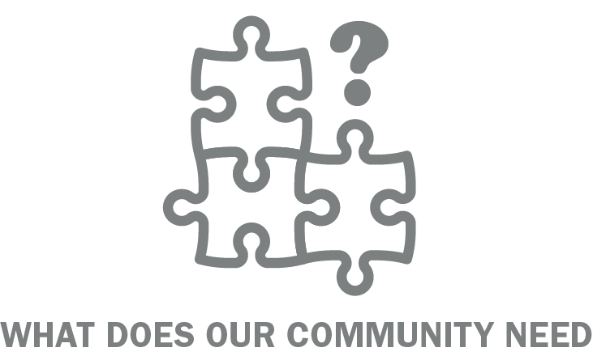
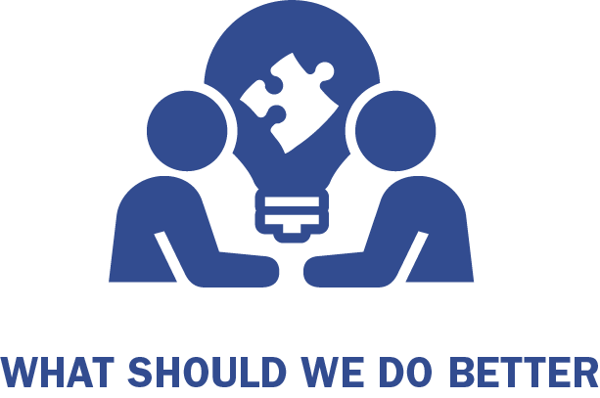
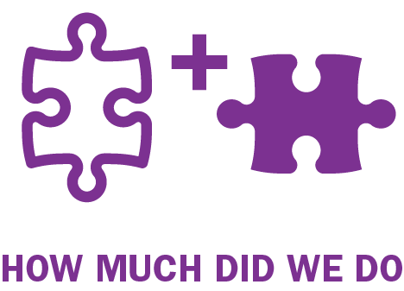
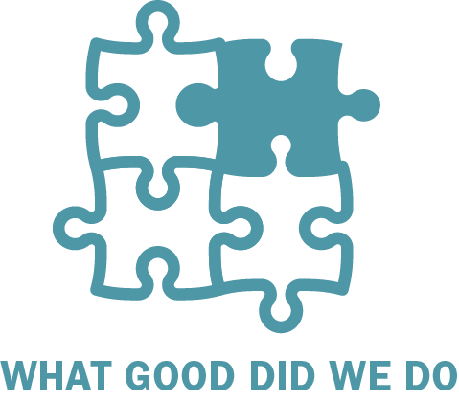
Demonstrating Library Value
Needs Assessment
Patron Satisfaction
Outputs
Outcomes
Notes:
Of course, measuring outcomes doesn’t mean you stop doing other types of evaluation. There are many data pieces that help demonstrate your library’s value.
Needs assessments help answer - What Does Our Community Need?
Patron satisfaction surveys help answer - What Should We Do Better?
Outputs, such as collection or door coutns, help answer - How Much Did We Do?

Slide 6
Demonstrating Library Value
Needs Assessment
Patron Satisfaction
Outputs
Outcomes
Notes:
Adding outcome data to your evaluation will help you answer the key question - What good did we do?

Slide 7
What is an Outcome?
Specific benefit from a library program/service
Can be quantitative or qualitative
Expressed as changes that individuals perceive
Answers the question:
Notes:
So what do we mean by outcomes? PLA defines outcomes as a specific benefit a patron receives from a library program or service. They can be quantitative or qualitative and are expressed as changed that individuals perceive in themselves.

Slide 8
Measuring the Good You Do
Learning what changes/effects/impacts your programs are having in/on…
Knowledge
Skills
Attitudes
Opinions
Behaviors
Actions
Status
Notes:
An outcome is a way to determine the extent to which a program achieved its intended results. By measuring outcomes, you’re learning what changes/effects/or impacts your programs are having.
So did the program positively impact the lives of the patrons?
Did it make a difference?
How are the lives of the patrons better as result?

Slide 9
Measuring the Good You Do
Supercharged Storytime Outcome Data
Improve Programs
Communicating Value
Creating Partnerships
Funding
Strategic Planning
Notes:
Supercharged Storytime outcomes capture how much caregivers are learning new techniques to help their children learn and is great data to use to meet a broad range of library goals:
While you are already presenting a great program, outcomes could help you understand areas that may need a little more strengthening
A key outcome of learning gained by patrons can be used to tell your library story to your board or friends group…”90% of participants that responded to the library survey said they learned something they can share with their children.”
You know that the library could expand its reach or strengthen community-level literacy goals through partnerships or with new funding streams. Measuring outcomes gives you data to help reinforce your message about how important Supercharged Storytimes are to the attendees.
And, if you have early childhood literacy goals that you are trying to reach, you can use outcome data to measure against those goals.

Slide 10
From the Field: Using Outcomes for Action
Notes:
Now we’ll talk about how the field has used outcome data gathered from the Project Outcome toolkit.

Slide 11
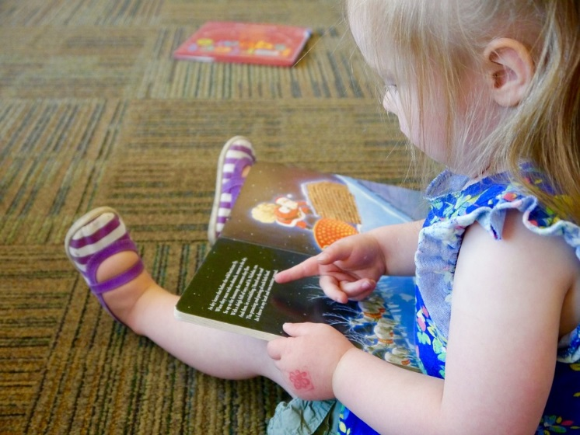
Program Improvements
Signing Storytime Survey Activity
Results: Pitch was too low
Fix: Raise the pitch
Cost: $0
Notes:
Douglas County Libraries in Colorado used the Early Childhood Literacy surveys for their Singing Storyimes. They found out form the surveys that the storytime was well-liked but that the pitch was too low for the little kids voices. The super simple fix was to raise the pitch so that the next time all the kids could join into the singing. It’ was a small change and didn’t cost anything but expanded the impact of the activity to all of the kids.

Slide 12
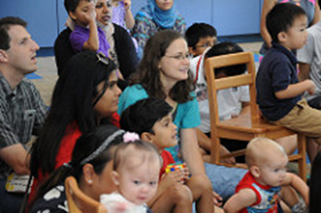
Program Improvements
Unique Storytime programs
Sign Language Storytime
Sensory Storytime
Storybook Mapping
Knightly Storytime
Count on Me
App Time
Sensory Storytime Survey Comments
“Music, Stories, Accepting--tolerates outbursts b/w/ autistic and typical children. It's a GREAT social skills practice for my kids.”
“Acceptance, patience, relationship, resources”
Notes:
Plano Public Library uses the Early Childhood Literacy survey to gather input from the patrons about a variety of storytime programs. From surveys completed during their traditional storytime programs rhyme time, toddler, time, and preschool storytime our patrons indicated that they would like additional programing. Plano responded by trying a wide variety of ideas, a few of which are listed on the screen here. They still support Every Child Ready Read in each of the formats, but hopefully in a way that might engage additional parents and children that might not attend our traditional programs regularly.
The surveys have given specific ideas such as Sensory Storytime for children with autism spectrum disorders. Also to Storytime Around the World. This a cycle of family storytimes in Arabic, Chinese, French, Hindi, and Spanish. With each language having a series of three to four storytimes.
.

Slide 13
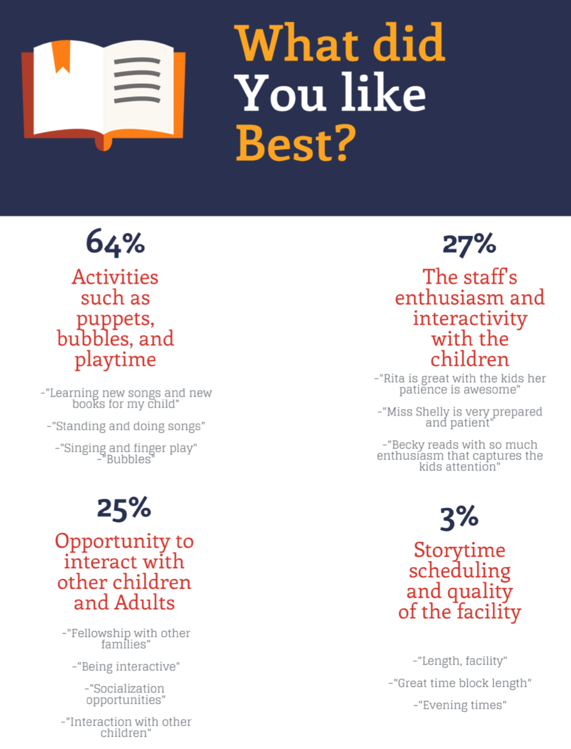
New Funding
Early Literacy Storytimes
Notes:
The Tulsa City-County Library used Project Outcome surveys to make programming decisions.
They measured their Storytime programs across several branches. Only one of the branches had designated playtime & toys for after Storytime.
To share their results, the library created an infographic that highlighted trends in the open ended comments.
The results showed that patrons liked and referenced the post-Storytime toys & playtime almost as much as the program itself.
As a result - The library was able to use its Friends of the Library group to fund toys for the other branches so they could provide the same post-Storytime activities more broadly.

Slide 14
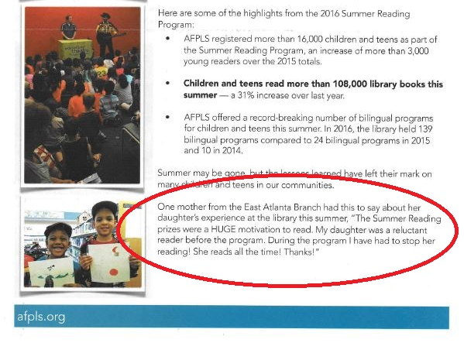
Communicating Results
Shared Summary Reports with Friends of the Library
Added patron comments in Library Board reports
Included patron comments in thank you notes to business donors
Notes:
The Atlanta-Fulton Public Library widely shared their summer reading survey results with their Friends group, Library Board, and to the businesses that donated summer reading prizes. They shared photos of the kids thanking the businesses, which the businesses really valued and shared via social media. Because of this, the library anticipates doubling their local business prize donations next summer. One parent’s comment even made it into the Library Foundation Newsletter, which goes out to library donors.
While note Early Childhood Literacy specifically, this is a great example of how wonderful it is to communicate results, sharing success & garnering support for future programming.

Slide 15
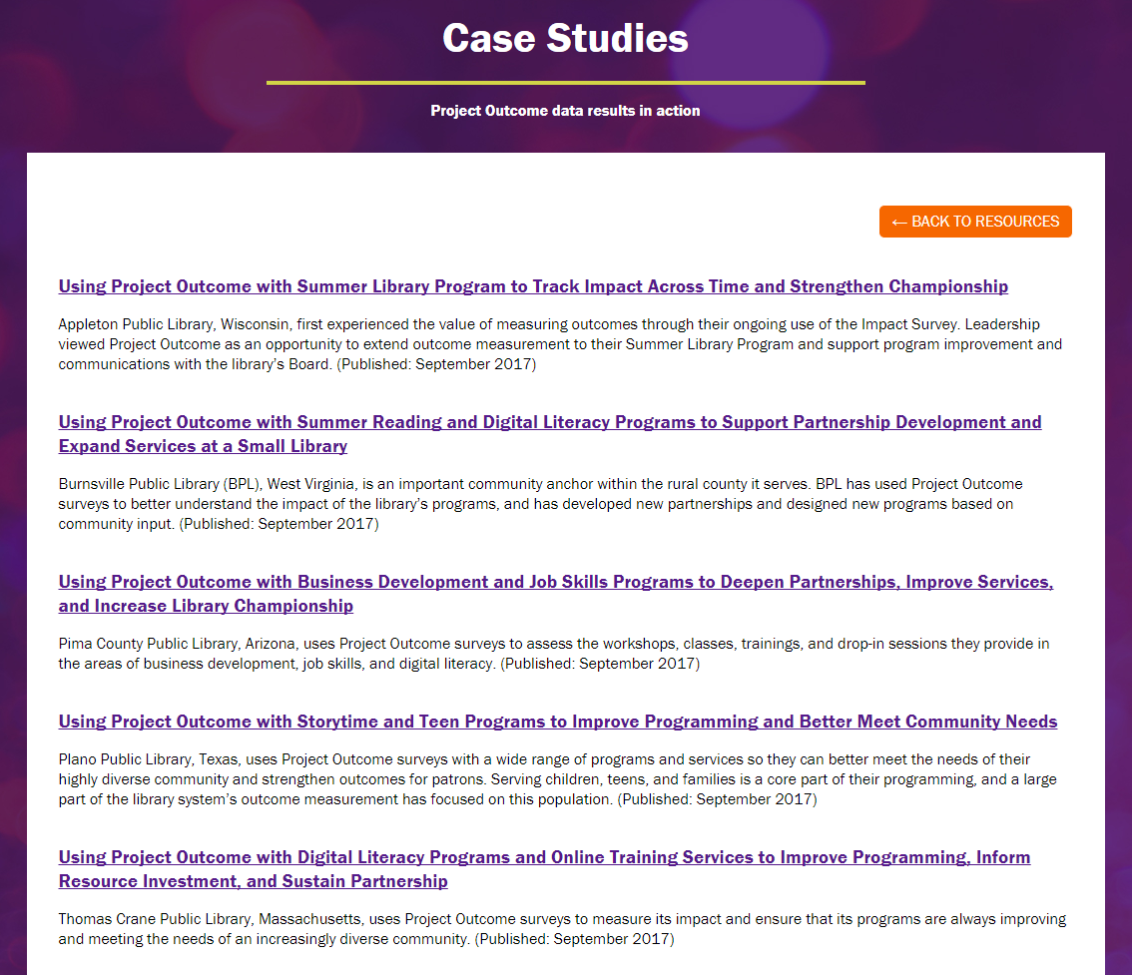
Find More Examples from the Field
www.ProjectOutcome.org
Notes:
You can find more examples like this under our From the Field resources on the Project outcome website, which include case studies, our speaker wall of fame, and on-demand webinars.

Slide 16
Project Outcome Toolkit

Slide 17
Project Outcome Toolkit
www.ProjectOutcome.org
Notes:
Everything you need to get started with Project Outcome can be found on the website, www.projectoutcome.org. Registration is free and only takes a few simple steps to begin.

Slide 18
Project Outcome Toolkit
It’s FREE!
Access to:
Quick & simple surveys
Easy-to-use survey tool
Custom data reports
Interactive data dashboards
Resources & training
www.ProjectOutcome.org
Notes:
The Project Outcome toolkit gives public libraries free access to:
Quick & simple surveys
An easy-to-use survey tool to collect and enter survey data
Custom data reports & interactive data dashboards for analyzing the results
& all of the resources and training we have created to help libraries throughout the outcome measurement process
We have heard from our users that the combination of the ready-to-go surveys and easy-to-use tools really help library staff save time and energy in planning their data collection, leaving more time for decision-making and advocacy once the results are in.

Slide 19
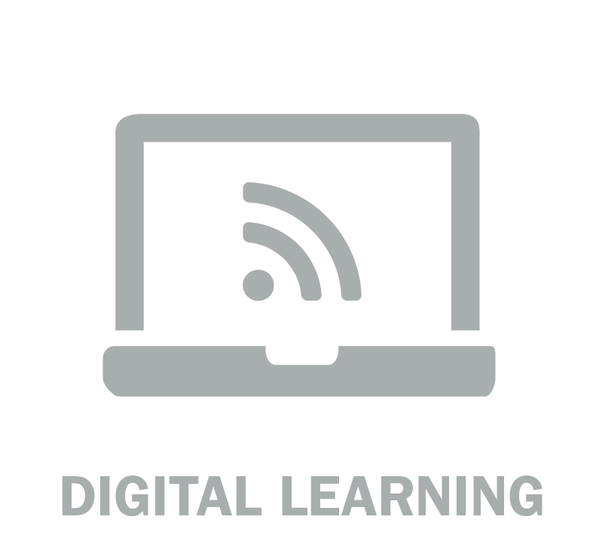
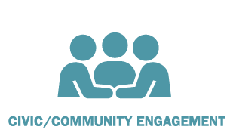
Survey Topic Areas
Notes:
You can access standardized surveys for 7 key topic areas that you’ll see here. For the Sueprcharged Storytimes program, you’ll want to use the Early Childhood Literacy survey.

Slide 20
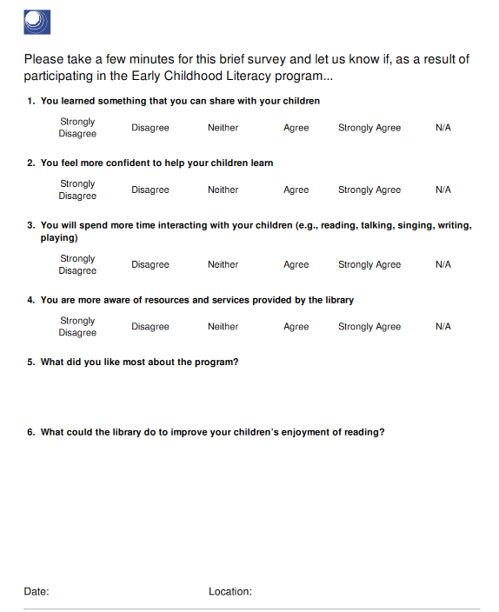
The Survey
Patron-Reported Learning
Open-Ended Feedback
Immediate Impact
End of Program
Notes:
As part of the SS training, practitioners will give their patrons the PO survey at the end of at least 1 storytime. The questions have a specific Early Childhood Literacy focus but are still standardized, allowing for you to collect data consistently should you chose to administer it more than once. The outcomes measured in the survey capture patron-reported changes in knowledge, confidence, behavior, and awareness of library resources related to this activity. There are also two open-ended questions that ask what the library did well and what can be improved. They take about 5 minutes to complete.
The 6-9 question survey, depending on whether you add questions in the toolkit, is completed by p/c at the end of a storytime. It can be completed in paper form at the library or on an ipad. If it’s done on paper, those results will need to be entered on the PO site. From there, you can build reports and learn more about p/c experience at your storytime.
Additionally, your state library can look at that data across the state with other SS libraries.

Slide 21
Benefits of Project Outcome Data
Capturing snapshot data
Short, simple surveys save time
Higher response rate from patrons
Open-ended comments are goldmine
We’ve done the heavy lifting for you!
Real-time results
Data visualizations
Ready-to-use reports
Notes:
Even though this is a brief introduction to Project Outcome, we hope we’ve shown some of the benefits of using Project Outcome surveys to collect outcome data.
The toolkit helps libraries quickly and easily capture snapshot data. This is not a tool for rigorous data collection and random sampling in your library. You’re targeting your users and finding out what they’re gaining and what else they need from the library to help support them in their learning.
The short, simple design of the surveys helps the library save time, while also increasing your response rate from patrons.
The open-ended questions of the surveys are a GOLDMINE for libraries. This is where they’re gaining the most insight into their community’s wants and needs.
Plus, we’ve done all the heavy lifting for you – with the standardized surveys, easy data entry, and ready-to-go visualizations and reports.

Slide 22
Benefits of Project Outcome Data
Standardization of outcome measures
Across time & locations
Variety of programs
Aggregate national & state comparisons
Notes:
The key benefit of using Project outcome for your evaluation, is that you’re using standardized outcome measures across time, multiple branches, and a variety of programs. So while your programs and audiences may be unique, by standardizing the outcomes, you’re able to talk about your impact across the board.
Which then allows your results to be aggregated with state and national datasets, for comparison sake, but also to talk about impact at a national level.

Slide 23
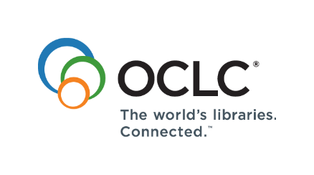
This project is funded by OCLC and by a grant from the Institute of Museum and Library Services, RE-95-17-0085-17

